Slide 1
Route 30A Autonomous Transit Workshop
Preliminary Findings
Presented by: Larry Gould
February 5, 2020

Slide 2
AgendA
Route 30A Autonomous Transit Workshop
Transit’s Role on Route 30A
Vehicle Options
Example Transit Cross-Sections
Transit Service Characteristics

Slide 4
Role of transit on route 30a
Allow residents and employees to avoid congestion
Encourage tourists and visitors to avoid driving to key destinations
Enable employees to get to work without needing a car
Improve sustainability and local air quality by reducing vehicle emissions

Slide 5
Transit demand segments
Commute trips
Errands and work-related trips
Shopping and social trips
Tourist and beach trips
Medical trips

Slide 6
Temporal patterns of demand
Commuting peak hours for local jobs (e.g. service-sector workers)
Late-night service to serve bars/restaurants
Year-round service
Peak season for tourism (i.e. April - November)

Slide 7
Development density and recommended service frequency
Evaluate:
Population density
Employment density
Evaluate transit propensity of key communities:
Older adults
Youth
People with disabilities
People of color
People with low incomes
Zero-vehicle households

Slide 8
Service design and trip purpose

Slide 9
Bus Stop Spacing

Slide 10
Brt designs

Slide 11
Vehicle Options
Electric on-demand transit (“club car”)
Autonomous electric club car
25’ electric shuttle
30’ transit bus
40’ transit bus
Electric 40’ transit bus
Autonomous electric transit bus (future)

Slide 12
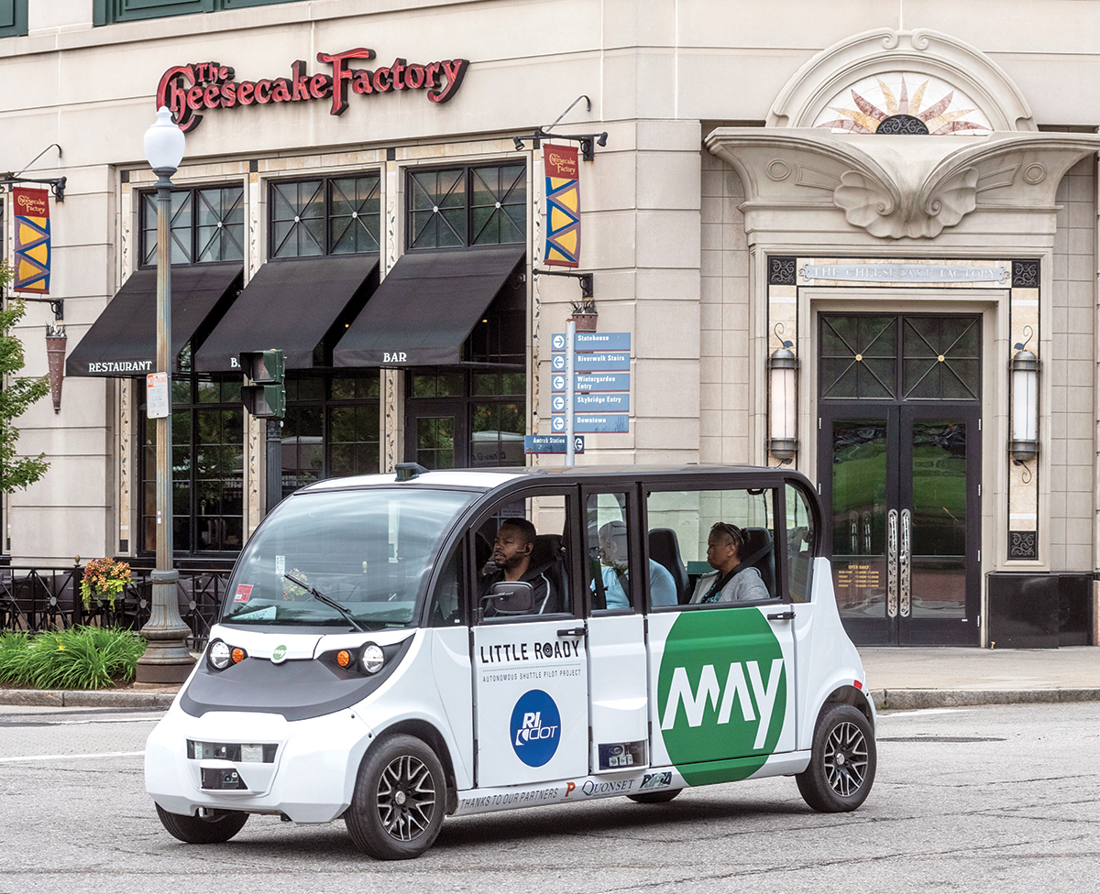
Electric On-Demand Transit (“Club Car”)
$15,000 - $30,000
Pros:
Inexpensive vehicles
Zero-emissions
Dedicated drivers (unlike autonomous)
Cons:
May not be ADA compliant
Limited battery range
Lower capacity than most transit buses or shuttles
Models: Polaris GEM, Chevrolet Bolt EV
Useful life: N/A

Slide 13
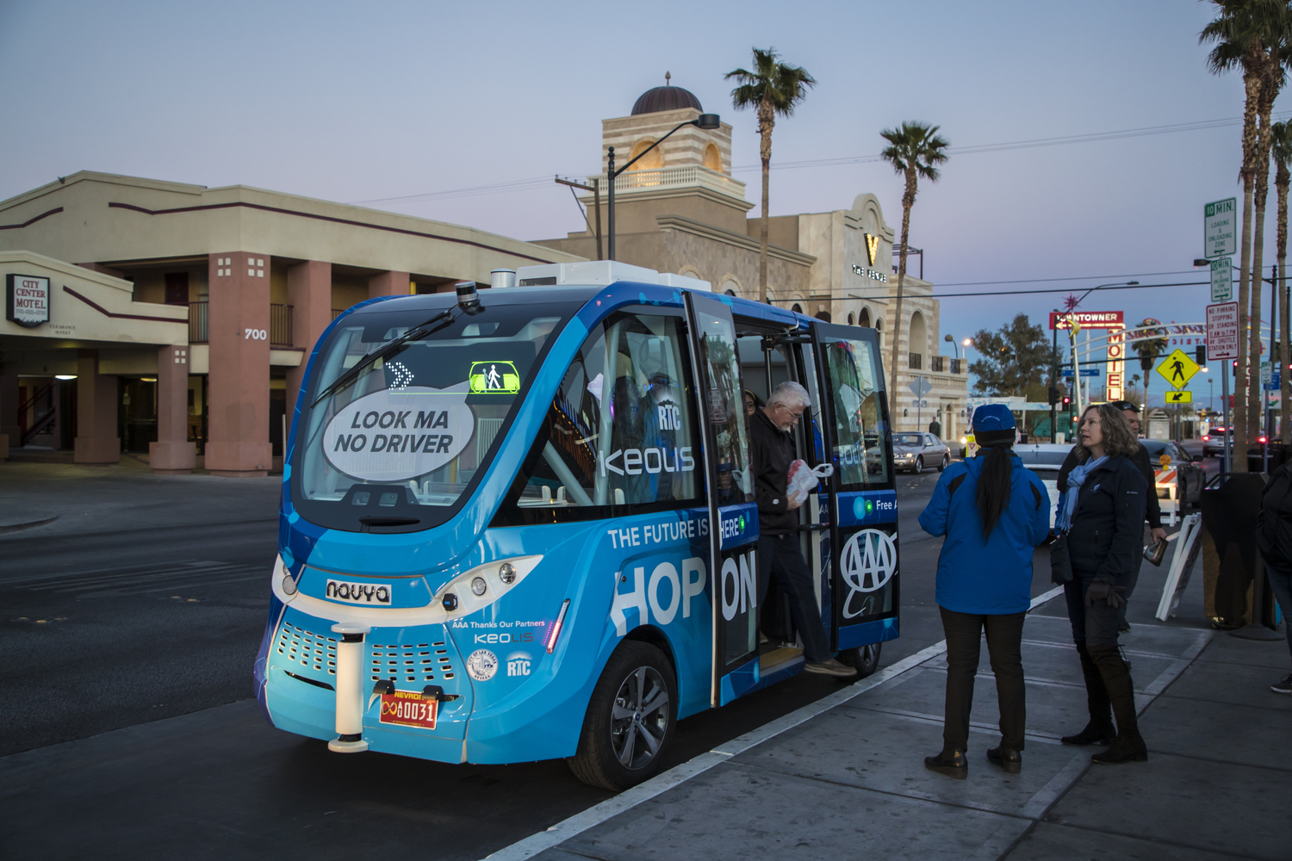
Autonomous Electric Shuttle
Pros:
Zero-emissions
Lease includes vehicle, insurance, maintenance, driver supervision
Cons:
Typically only operated at speeds below 20 mph (max. is 35 mph), limiting their use on certain corridors
May not be ADA-compliant
Limited battery range (30-60 miles)
Lower capacity than transit buses or shuttles (10-15 pax.)
Models: Navya Arma, EZ10
Useful life: Not yet established
$150,000 per year (lease)

Slide 14
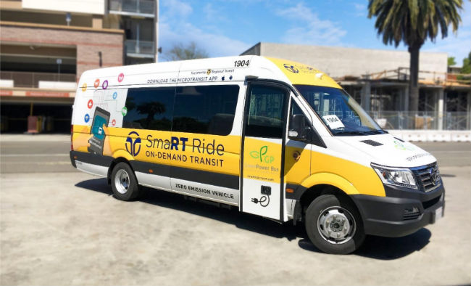
25’ Electric Shuttle
$350,000 - $600,000
Pros:
ADA compliant
Higher capacity than club car
Narrower width (9’) than 40’ transit bus
Cons:
Higher maintenance costs
Manufacturers: New Flyer, Daimler, TransTech, Gillig, Schetky, Volvo
Useful life: 12+ years

Slide 15
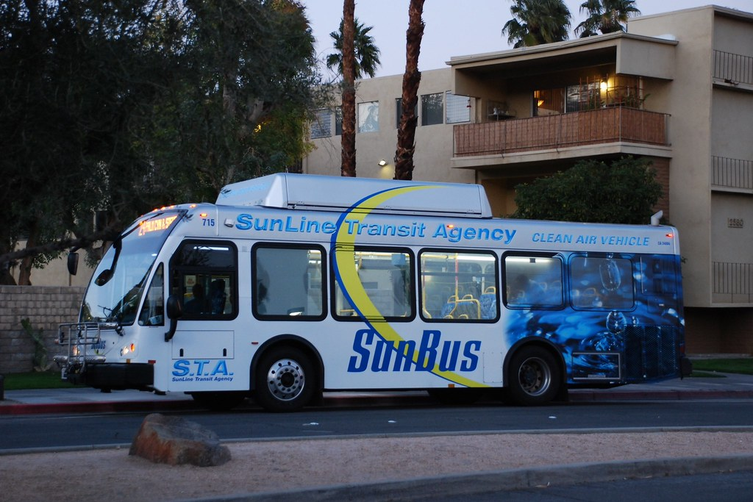
30’ Transit Bus
$450,000 - $600,000
Pros:
Common to many transit fleets
ADA compliant
Higher capacity than either club car or 25’ electric shuttle
Cons:
Lower capacity than 40’ transit bus
Wider vehicle requires more street space (11’)
Manufacturers: New Flyer, Daimler, TransTech, Gillig, Schetky, ElDorado
Useful life: 12+ years

Slide 16
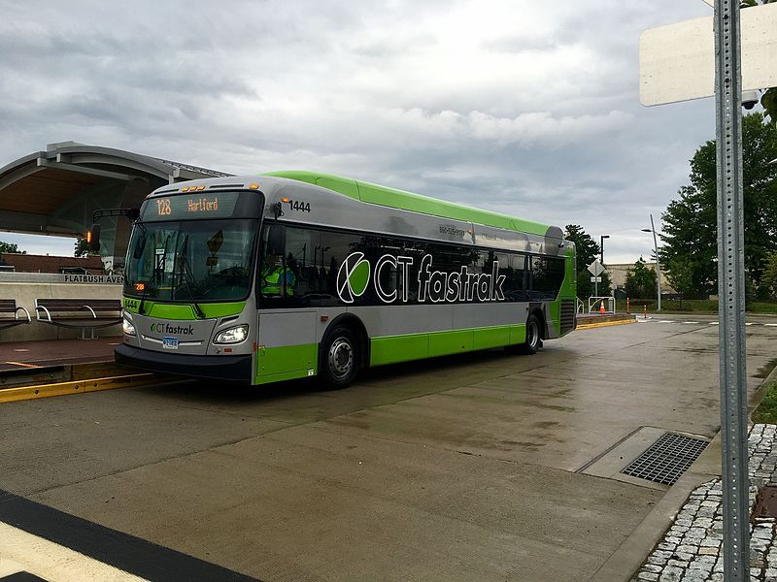
40’ Transit Bus
$500,000 - $600,000
Pros:
Common to many transit fleets
ADA compliant
Higher capacity than either club car or 25’ electric shuttle
Cons:
Higher maintenance costs than electric transit buses
Wider vehicle requires more street space (11’)
Manufacturers: New Flyer, Daimler, TransTech, Gillig, Schetky, Volvo
Useful life: 12+ years

Slide 17
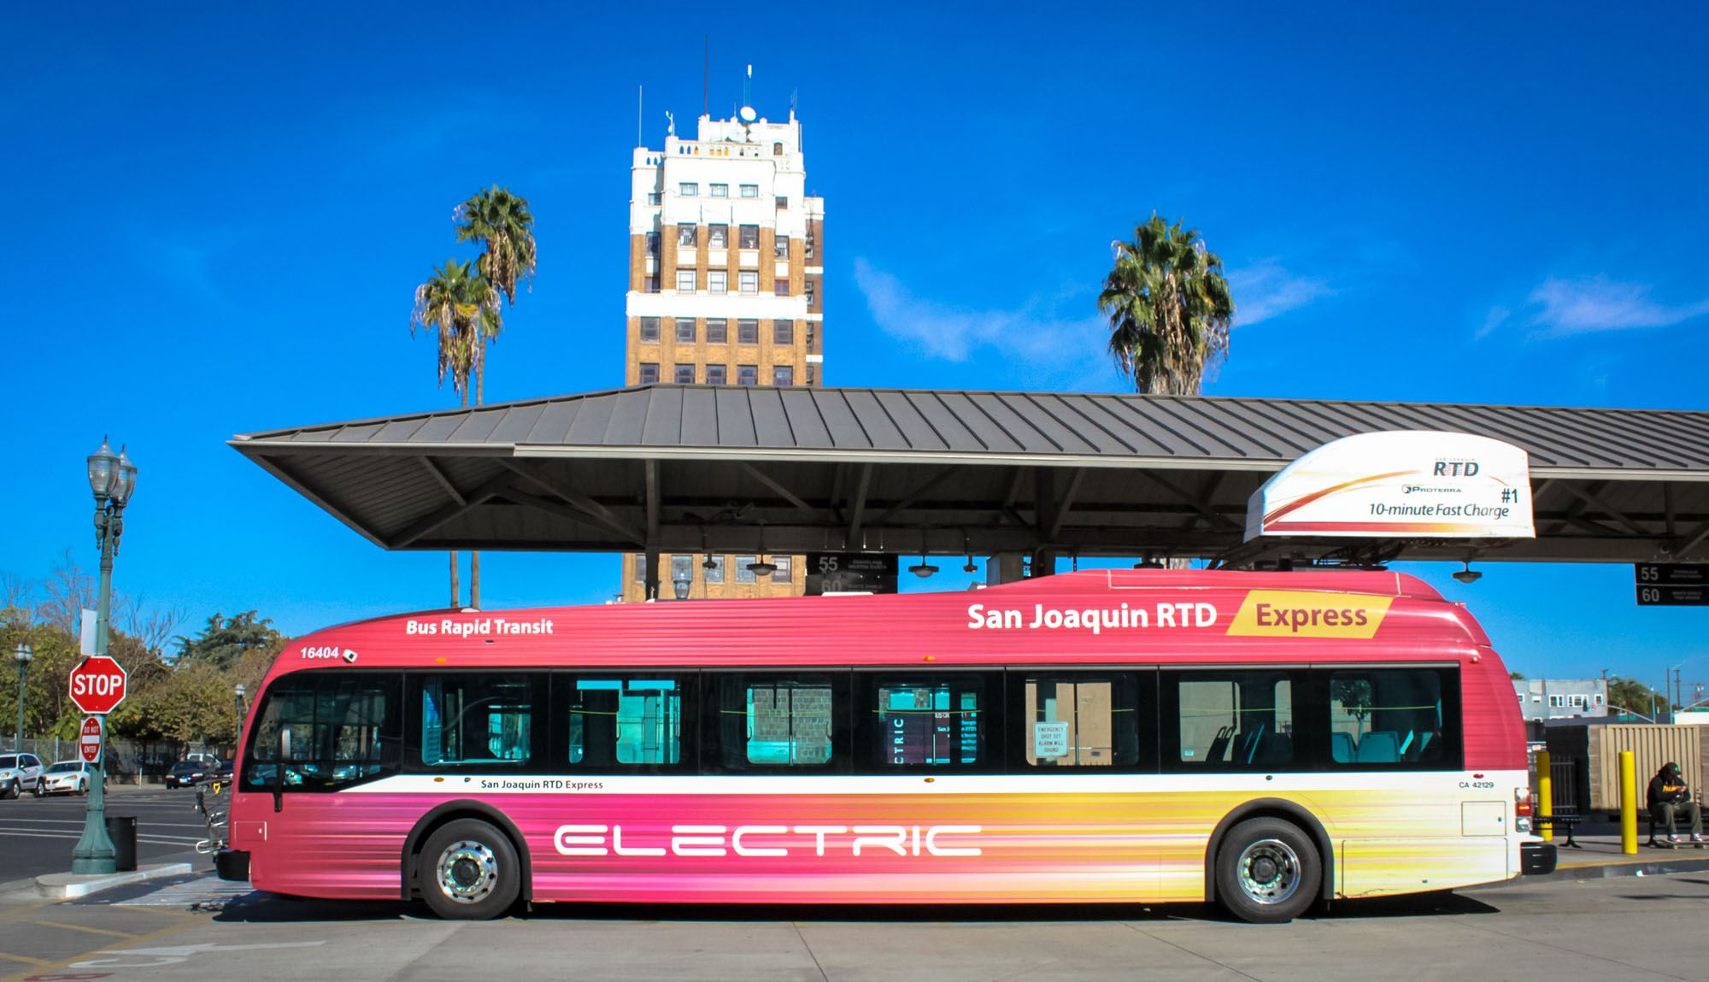
Electric 40’ Transit Bus
Pros:
Zero-emissions and reduced noise
ADA compliant
Higher capacity than transit bus
Cons:
Limited battery range
Highest maintenance costs
Wider vehicle requires more street space (11’)
Manufacturers: Proterra, New Flyer, Green Power, BYD, Smith Electric Vehicles
Useful life: 12+ years
$700,000 - $1 Million

Slide 18
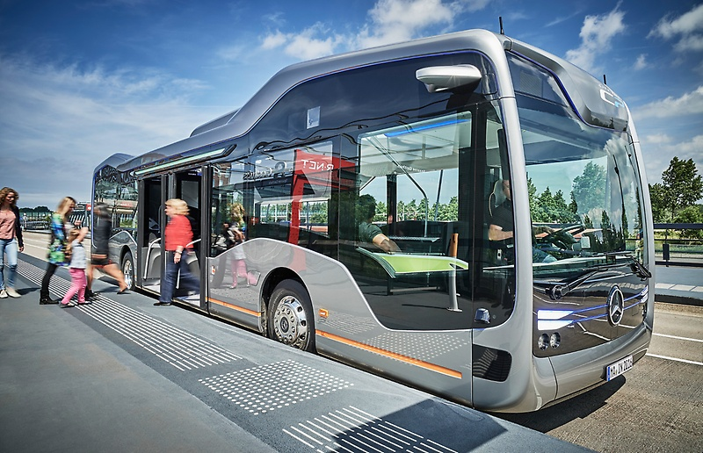
autonomous Transit Bus
Pros:
Zero-emissions
ADA compliant
Higher capacity than transit bus
Lower operating costs than non-autonomous buses
Cons:
Still in development
Limited battery range
Highest maintenance costs
Wider vehicle requires more street space (11’)
Manufacturers: Mercedes-Benz
Useful life: Not yet established

Slide 19
Potential Roadway designs
Bidirectional, single transit-only lane in roadway center on south side of 30A

Slide 20
Potential Roadway designs
Two uni-directional, shared transit/micro-mobility lanes
Image Source: NUE Urban Concepts

Slide 21
Potential Roadway designs
Two uni-directional, shared transit/micro-mobility lanes
Image Source: NACTO

Slide 23
Bus priority

Slide 24
Transit Signal Priority

Slide 25
Queue Jump Lanes
Image Source: AC Transit

Slide 26
Potential bus stop designs
Boarding bulb stop

Slide 27
Potential bus stop designs
Curbside Pull-out stop
Image Source: NACTO

Slide 28
Potential bus stop designs
Side boarding island stop

Slide 29
Potential bus stop designs
Park-and-ride

Slide 30
Potential bus stop designs
Park-and-ride

Slide 31
Potential bus stop designs
Median Stop, Right-Side Boarding
Image Source: NACTO

Slide 32
Potential bus stop designs
In-Lane Sidewalk Stop
Image Source: NACTO

Slide 33
Potential Daily Ridership
Transit Mode Share | Average Daily Traffic (ADT): 12,000 | Average Daily Traffic (ADT): 18,000
5% | 600 | 900
10% | 1,200 | 1,800
20% | 2,400 | 3,600
30% | 3,600 | 5,400

Slide 34
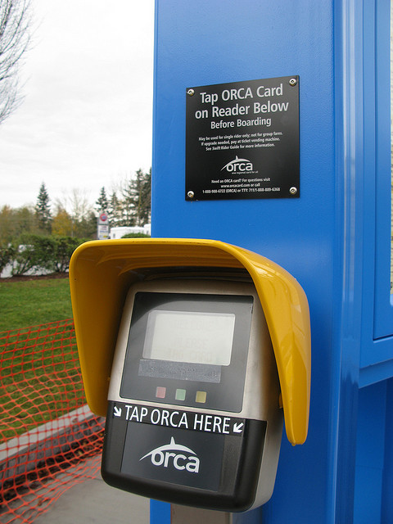
Potential fare structure
Fare-free
Fare, with off-board fare payment to reduce bus dwell time

Slide 35
Role of Transportation demand management (TDM)
Demand management
Commuter benefits incentives to encourage sustainable modes (e.g. free transit passes for employees)
Transit-oriented development
Form-based codes
Reduced minimum parking requirements
Pricing of public parking
Expansion of bike, pedestrian facilities (e.g. bike share, scooters)
Supply management
Joint-use/shared parking agreements
Public/private parking agreements

Slide 36
Larry Gould
646.274.3725
lgould@nelsonnygaard.com

Slide 37
PNG Originals: O:\software tools\Icons\NN Icons PNGs

Slide 38
PNG Originals: O:\software tools\Icons\NN Icons PNGs

