Slide 1
Autonomous Vehicles and
CR 30A in Walton County

Slide 2
MAYA
Most Advanced, Yet Acceptable
Raymond Loewy – Industrial Designer

Slide 3
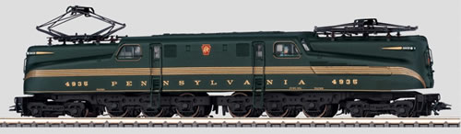
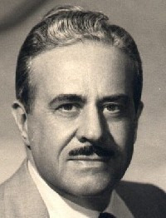
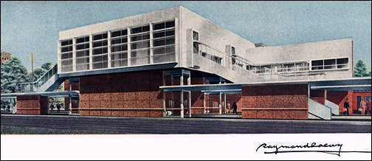
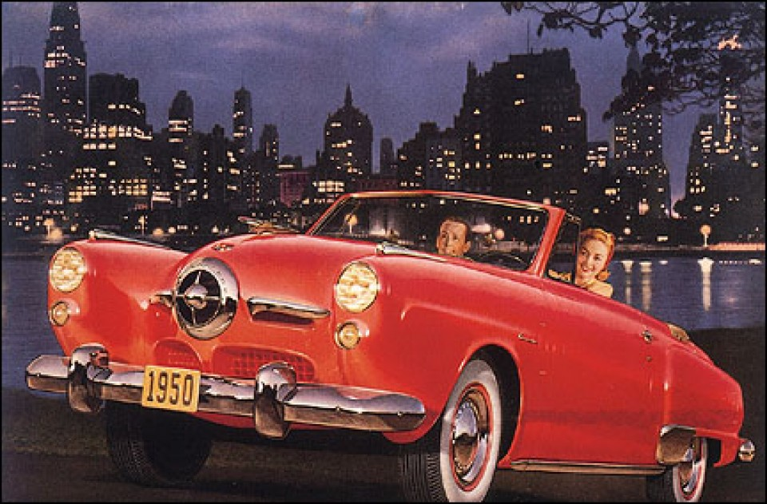
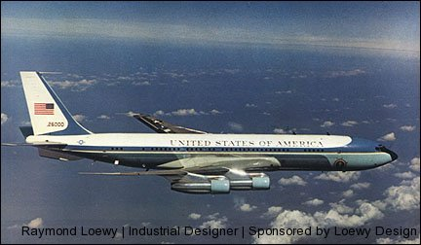
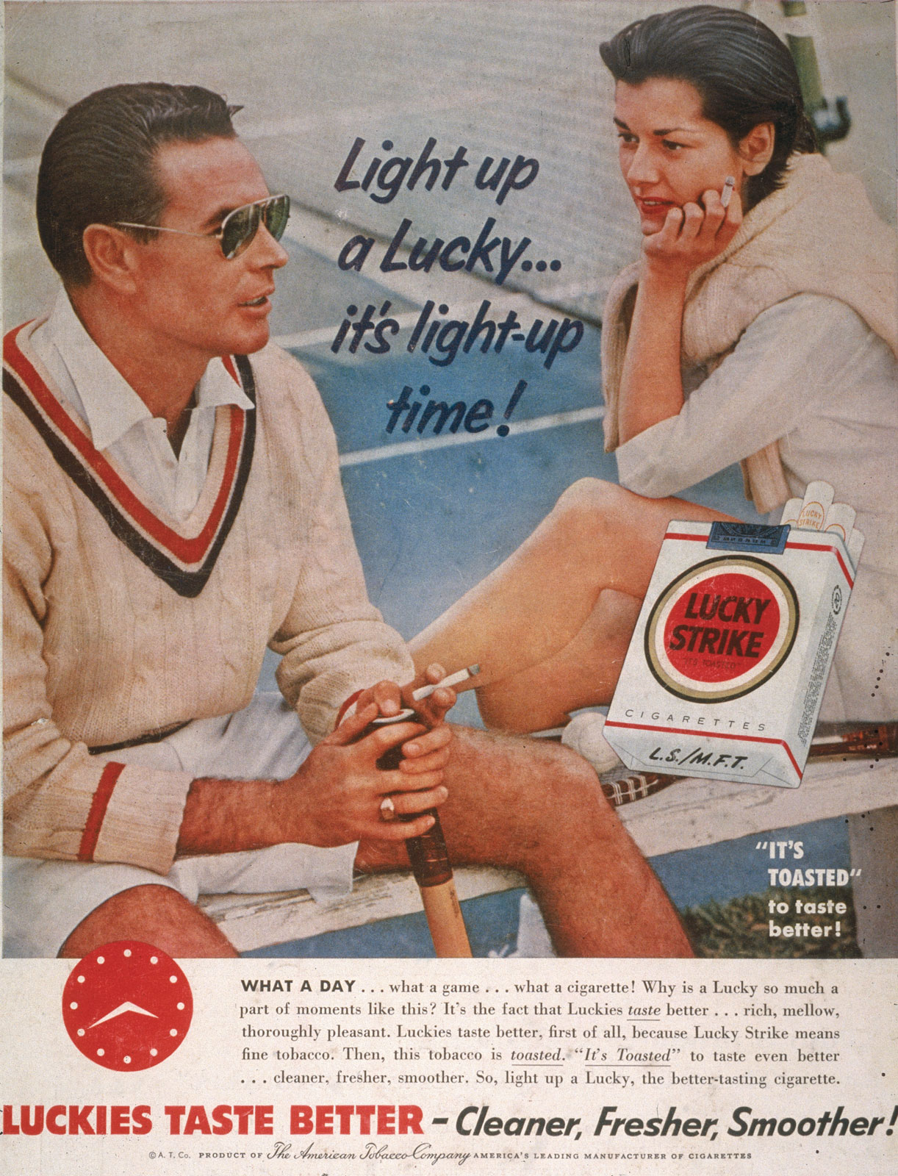
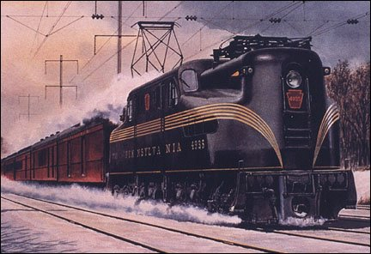
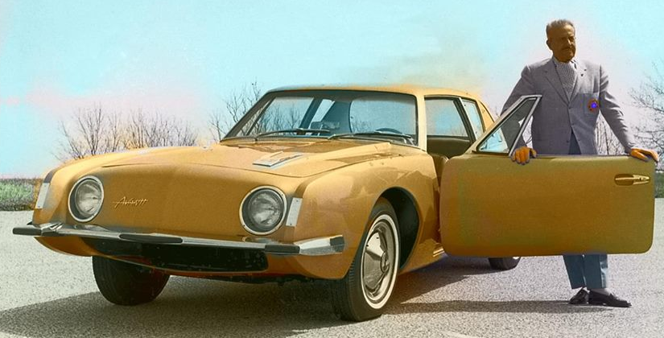

Slide 4
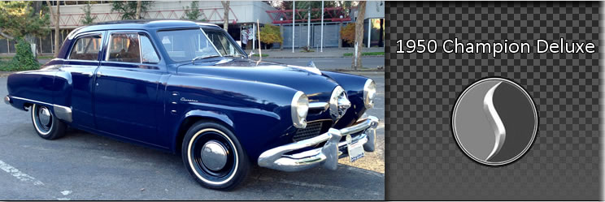

Slide 5
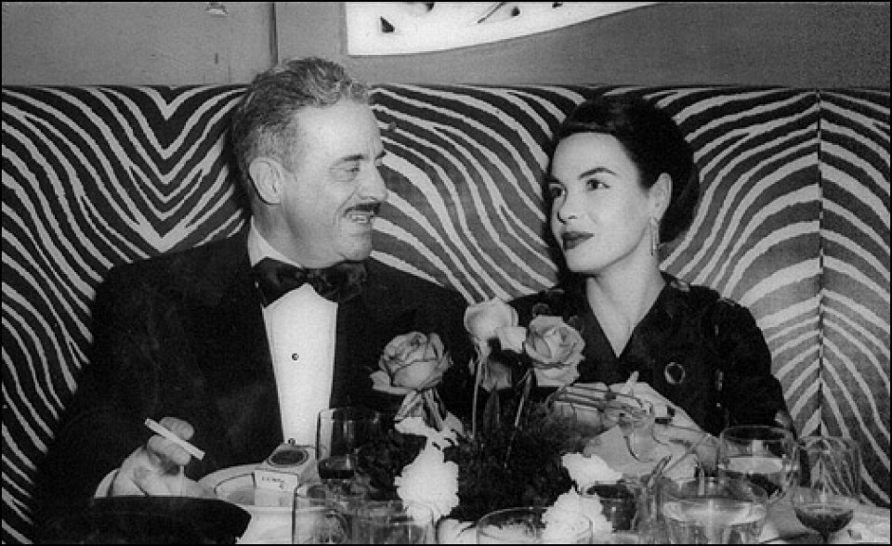

Slide 6
MAYA
MA most advanced
YA yet acceptable
MANA
MA most advanced NA not acceptable
LAYA
LA Least advanced YA yet acceptable

Slide 7
LU1 > TR2
The land use/development pattern must lead the transportation designs
South Walton had this right for 30 years
Bay Co. just starting to, w Downtown Plan

Slide 8
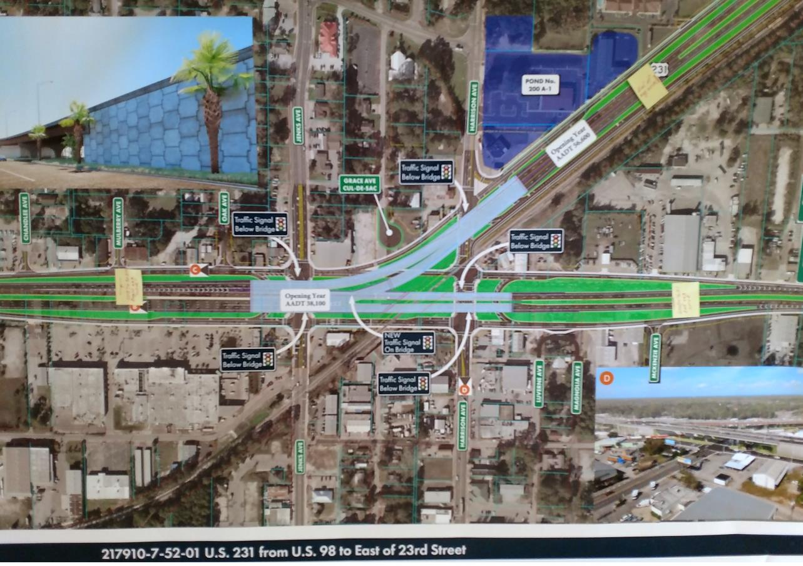

Slide 9
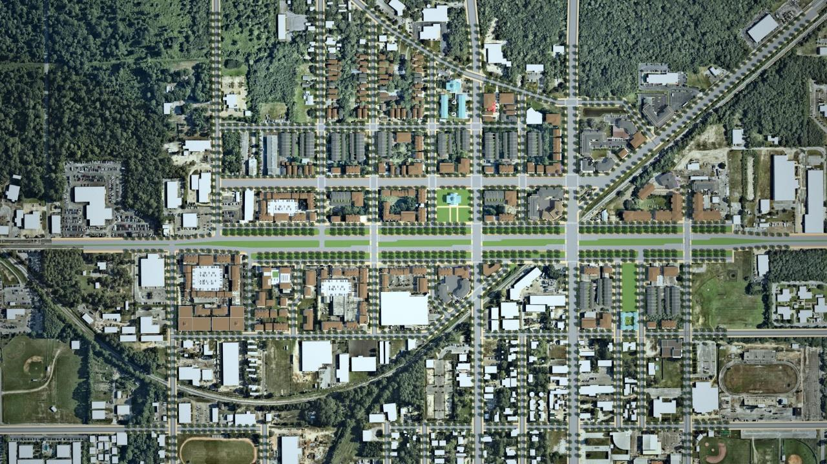

Slide 10
CONTEXT
Transect by Andres T1 to T6
FDOT C1 to C6 Carver/Hattaway
Network and Street Design by context solves many conflicting debates

Slide 12
CONGESTION!
Where? at Intersections!!
When? in Peaks.
  annually, weekly, daily
Whom? Prioritize.
  motor vehicles, cycles, walkers
What Cost?
  the Chattanooga Christmas Party.

Slide 15
DELAY & CAPACITY
Two seconds per vehicle
1,800 per hour
  2 / 60 = 30/min
  30 x 60 = 1,800 / hour green time
  50% Green time = 900 veh/hour

Slide 18
For Whom
are we planning to reduce congestion?
Must Prioritize
  bicycles
  walkers
  transit
  motor vehicles
Shift to smaller vehicles and group travel

Slide 19
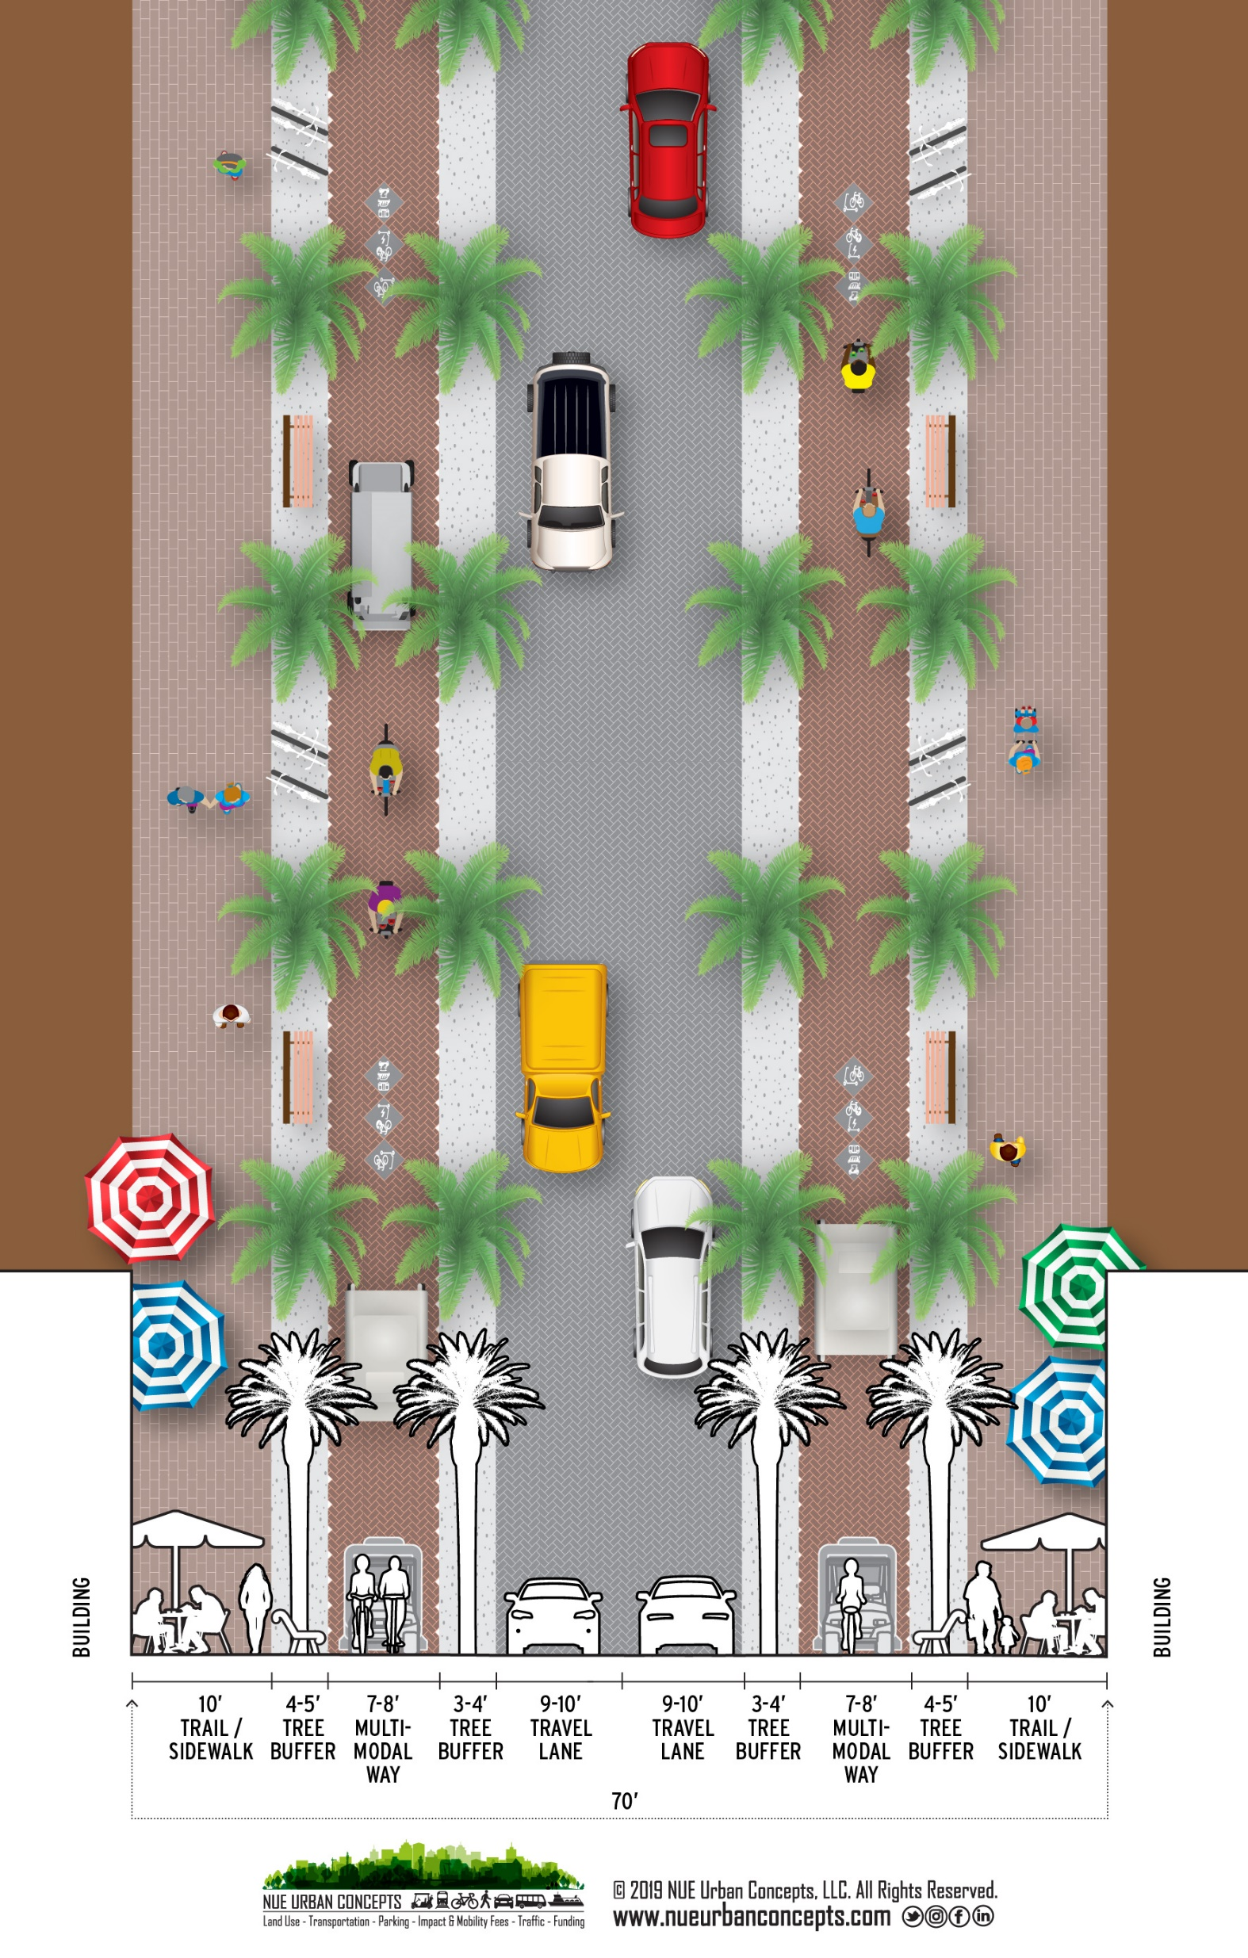

Slide 20
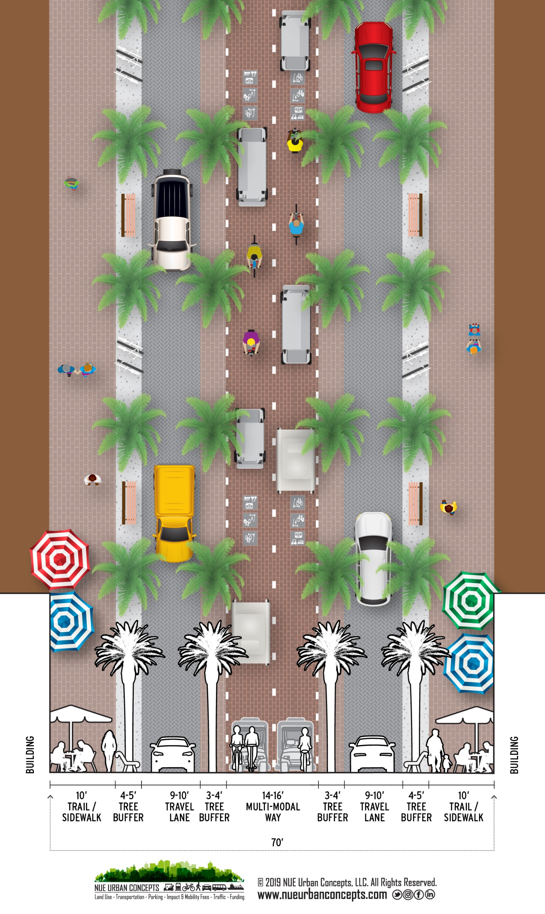

Slide 21


Slide 22


