Slide 1
We Can’t Wait:
Maintaining Progress on Climate
Shelley Poticha, Director, Urban Solutions

Slide 2



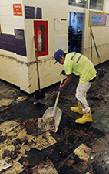
These Are Unprecedented Times
Notes:
Opportunity of clean energy technology is better than ever
Public is mobilized
People are feeling the pain of inaction

Slide 3
Trump’s EO creates an ever-widening gap
By 2030, Trump’s executive order would result in an emissions gap of nearly 1,700 million tons compared to a 2 degrees pathway
Obama Admin
Gap of 1,680 MMT to reach 2 degrees pathway
Source: Historical data is from EPA’s Greenhouse Gas Inventory, 1990-2015. Climate Action Plan and Trump EO projections are derived from the Rhodium Group, “Trump’s Regulatory Rollback Begins”, March 2017.

Slide 4
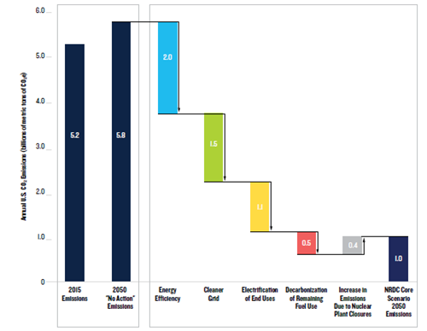
We Know It’s Possible
Source: America’s Clean Energy Frontier: The Pathway to a Safer Climate Future. NRDC September 2017

Slide 5
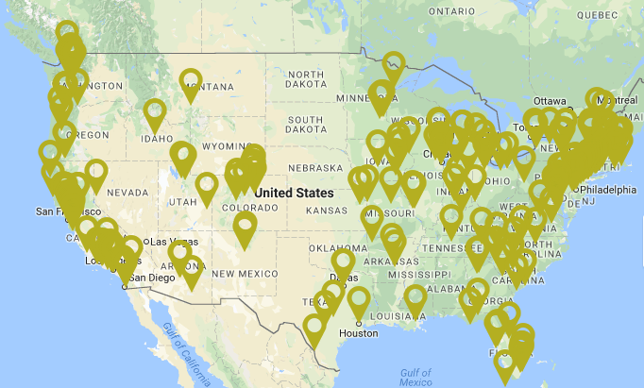
Maintaining Local + State Progress

Slide 6
Policy & Market Alignment
States adopt policies and direct utilities toward:
-- energy efficiency programs and investment
-- renewable portfolio standards
-- vehicle standards, EV infrastructure, transit
-- State & regional carbon markets
--Equitable rate design & utility business models
--Incorporating future climate impacts into infrastructure design and land conservation programs
State
Cities can lead and show demand:
-- Deep energy efficiency retrofits & solar on municipal buildings
-- Using procurement for renewables & fleets
-- Benchmarking ordinances & One-stop-shops
-- Congestion charging zones
-- Solar equity programs for disadvantaged
communities
-- Land use, place-making, urbanism
City

Slide 7
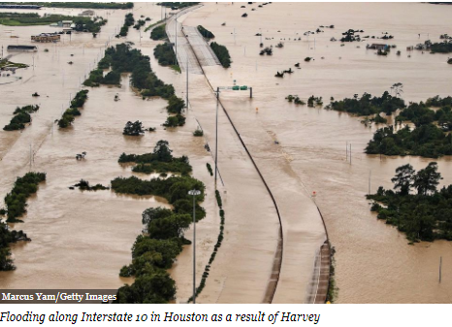
Mitigation Isn’t Enough – Resiliency must be a priority for all of us
A recent study by Rice University found that FEMA failed to capture 75 percent of flood damages within their flood maps between 1999 and 2009.
FEMA flood maps are the primary source for how the government and insurance companies evaluate flood risk and insurance premiums.
There are collectively trillions of dollars worth of property that rely on these maps being accurate.

Slide 8

We Can’t Wait!
In addition to cutting climate emissions:
Healthier People
Safer Communities
Jobs and New Businesses
A Stronger Economy
Hope for the Next Generation

