Slide 1
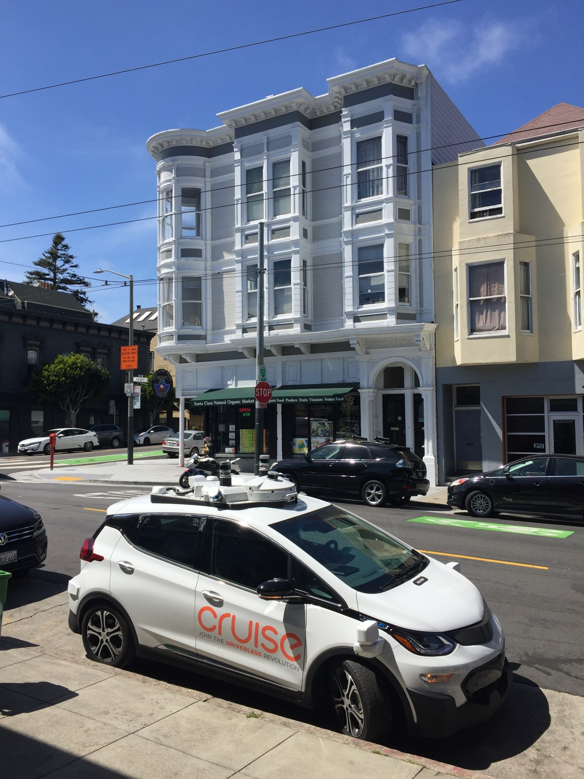
Harnessing Self-Driving Vehicles
Actions to Take Today for Better Cities Tomorrow
Presented by Patrick Siegman
AVs & Route 30A Workshop
Seaside, Florida
February 6, 2020
Notes:
Misguided parking & transportation policies are harming our cities today.
Now that autonomous vehicles are entering regular passenger service, these misguided policies are becoming even more harmful.
Cities that have removed these misguided policies are already benefiting, and will benefit even more from these reforms as autonomous vehicles become widespread.
Many cities have adopted additional smart reforms, which are beneficial today, and which will help them reap benefits from the advent of autonomous vehicles.
Session title and description in the conference program:

Slide 2
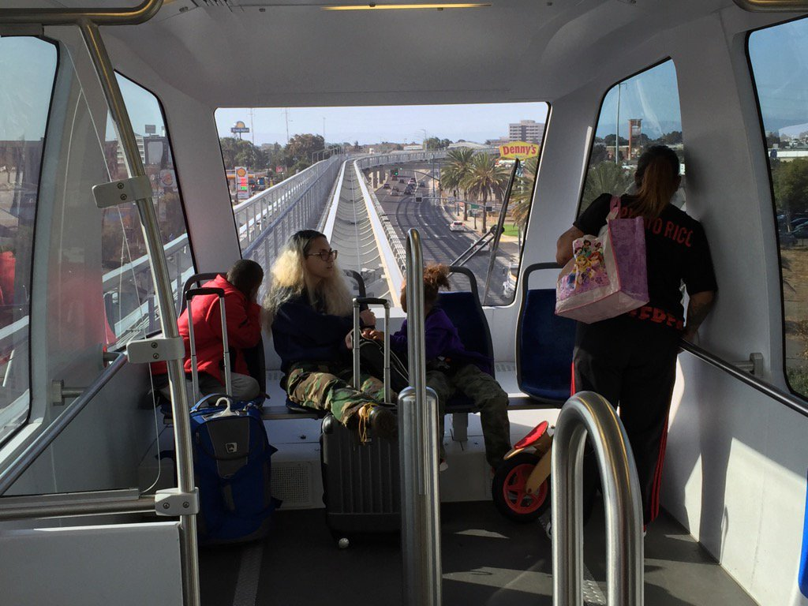
Self-driving vehicles & mobility as a service: what’s happened already?

Slide 3
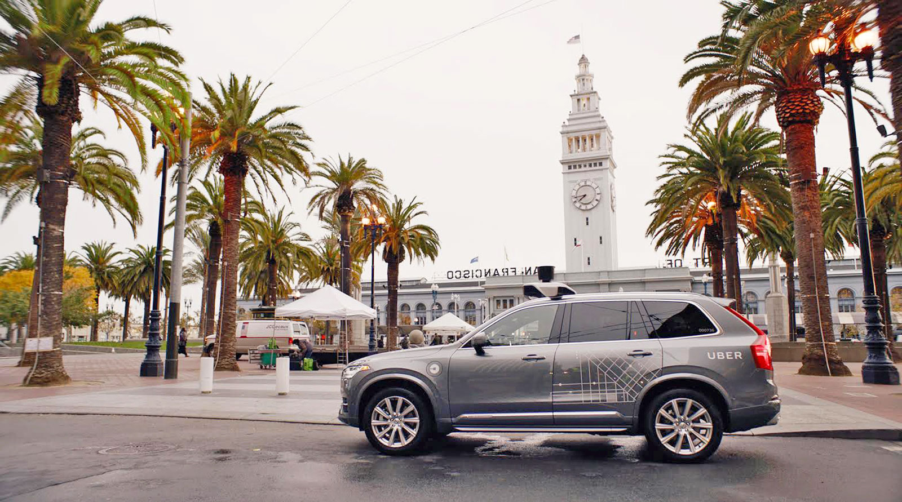


Ridehailing = ~15% of intra-San Francisco vehicle trips in 2016
Ridehailing = ~9% of intra-SF person trips
Source: SFCTA. 2016 data. See https://www.sfcta.org/tncstoday
Notes:
https://www.sfcta.org/tncstoday.
“The information presented is a profile of estimated local TNC usage (trips made entirely within San Francisco) from mid-November to mid-December of 2016. The TNC data was originally gathered by researchers at Northeastern University from the Application Programming Interfaces (APIs) of Uber and Lyft and then shared with the Transportation Authority. The Transportation Authority’s data team cleaned and analyzed the data for presentation here.“

Slide 4
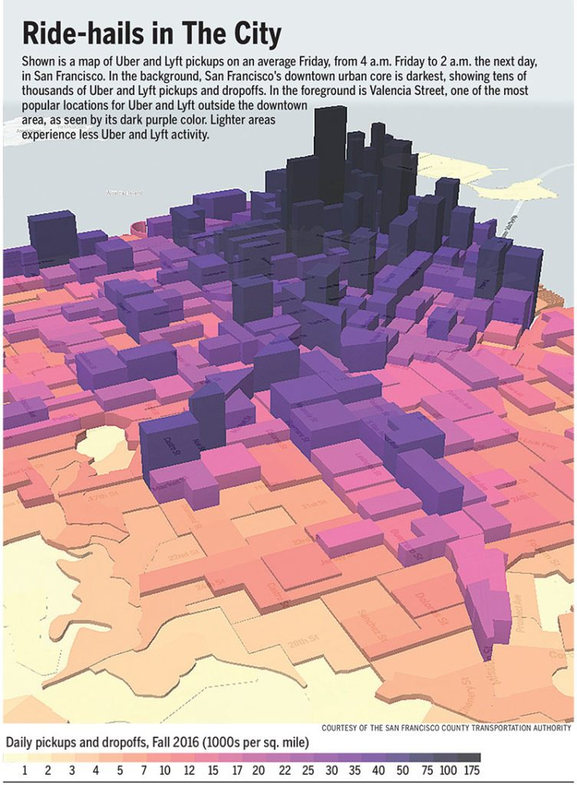
Ridehailing in SF, 2016
Ride-hail trips concentrate in densest, most congested areas
At peak periods, ride-hail vehicles = 20-26% of vehicle trips in Downtown & South of Market
Source: SFCTA. 2016 data. See https://www.sfcta.org/tncstoday

Slide 5
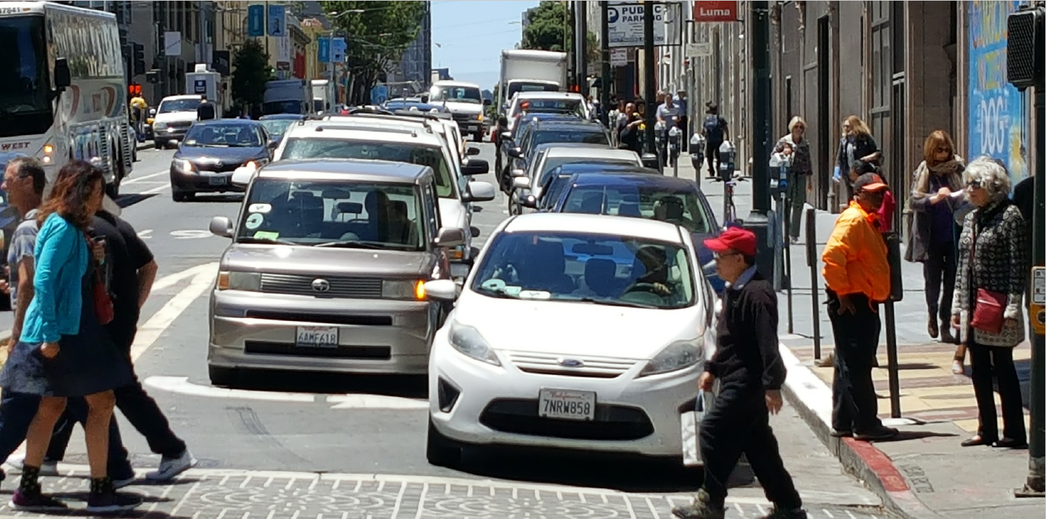
San Francisco, 2010 – 2016: Uber & Lyft caused 2/3 of the 62% rise in vehicle hours of delay over those 6 years
Traffic modeling that excluded Lyft & Uber show hours of delay would have only increased 22% in their absence
43-61% of ride-hail trips substitute for transit, walk, bike or no trip
Source: SFCTA & University of Kentucky.
https://archive.sfcta.org/sites/default/files/content/Planning/TNCs/TNCs_Congestion_Report_181015_Final.pdf

Slide 6
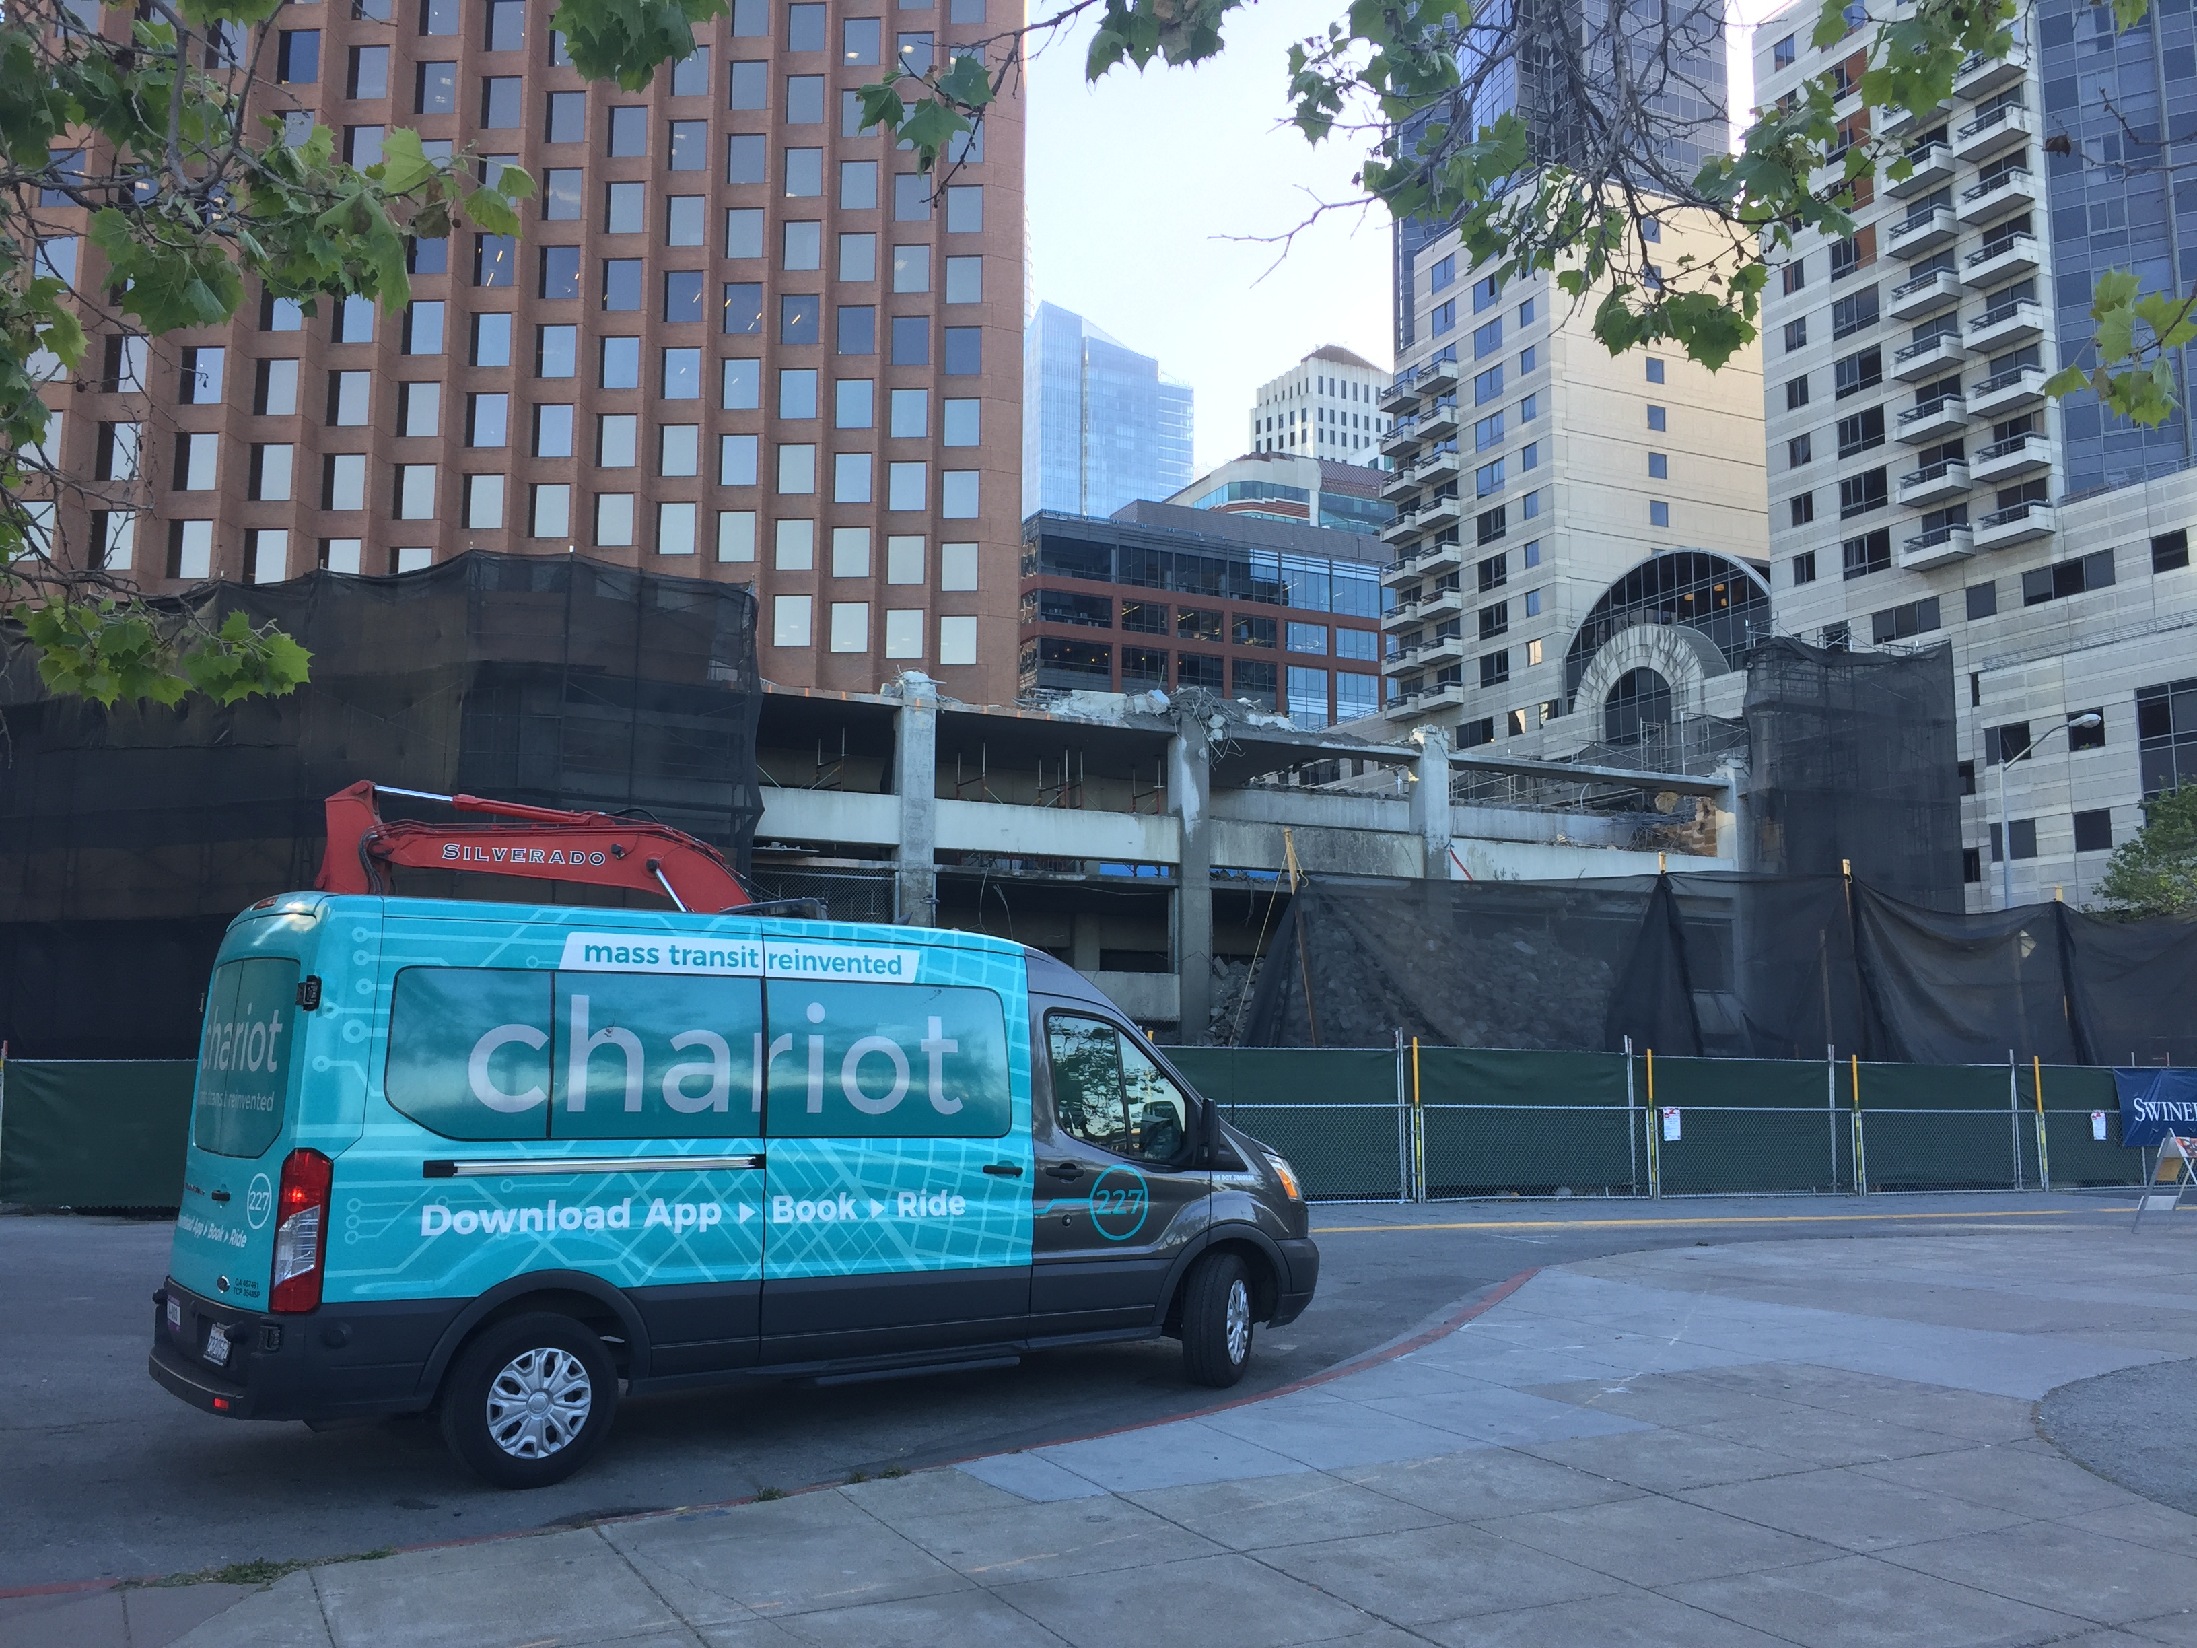
Ridehailing is cutting parking demand & revenues
Source: City and County of San Francisco Office of the Controller, Budget Status Reports
San Francisco Parking Tax Revenue ($ Millions)
Fiscal Year | Revenues
FY 2014-15 | $87.2
FY 2015-16 | $86.0
FY 2016-17 | $84.3
FY 2017-18 (projected) | $83.4
Notes:
Despite strong economic growth, San Francisco parking tax revenues have been steadily declining. City officials attribute the decline to ridehailing. For FY 2016-17, the City had budgeted $92.8 million based upon past parking revenue growth trends, inflation, population and economic growth, but actual revenues for that year came in at just 84.3 million, and $11.5 million shortfall. For FY 2017-18, projected year-end revenues based on the first six months of actual revenues are $83.4 million, which would be a 0.8% decline from the previous year.
Source: City and County of San Francisco Office of the Controller, Budget Status Reports.
https://sfcontroller.org/sites/default/files/FY%202015-16%209-Month%20Report-%20FINAL.pdf
http://sfcontroller.org/sites/default/files/Documents/Budget/FY%202016-17%209-Month%20Report%20FINAL%20-%20Revised.pdf
https://sfcontroller.org/sites/default/files/Documents/Budget/FY18-19%20and%20FY19-20%20MFS%20FINAL_0.pdf

Slide 7
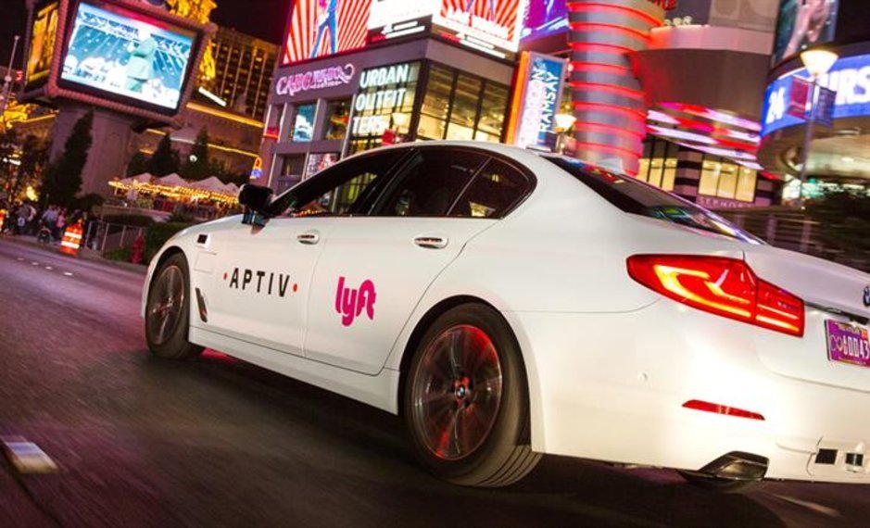
Ridehailing “taking a big bite” out of the parking industry
“At San Diego hotels serviced by Ace Parking, overnight parking has declined 5% to 10%. At restaurant valet stands, business is down 25%...nightclub valets are seeing a 50% drop off…Ace Parking has seen similar declines at its 750 parking operations from Washington, D.C., to Portland, Oregon.”
Notes:
Source: http://www.sandiegouniontribune.com/business/growth-development/sd-fi-ace-parking-uber-lyft-competition-20180222-story.html

Slide 8
Self-driving shuttles and taxis are now picking up passengers on public streets
A few examples

Slide 9
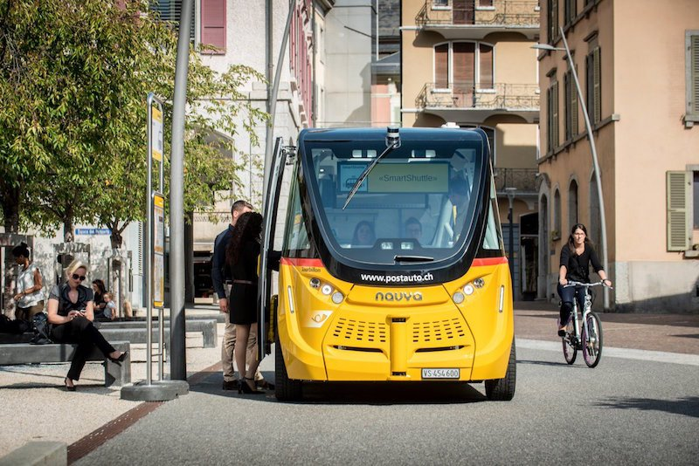
2016: NAVYA self-driving shuttles entered passenger service in the mainly pedestrian precincts of Sion, Switzerland
Photo: Twitter
Notes:
“The company has already delivered 45 ARMA [11-seater electric autonomous shuttle vehicles] around the world...”
Source: http://insideevs.com/navya-says-it-will-build-25-fully-autonomous-shuttle-buses-by-end-of-2017/
https://lenews.ch/2017/06/30/swiss-driverless-buses-a-hit-despite-accident/
Swiss driverless buses a hit despite accident
30/06/2017 By Peter Hulm
By Peter Hulm
“Sion’s driverless public shuttle buses celebrated their first anniversary of experimental operation in the mainly pedestrian precincts of the Valais capital on 23 June 2017.
Source: Twitter
Switzerland’s PostAuto/PostBus, responsible for the 11-seater yellow electric vehicles built by the French company Navya, said the two SmartShuttles carried more than 21,500 people through the Sion city centre during the year.
That averages at 69 per half-day (the buses run only in the afternoon and not every day). But PostAuto stresses these passengers included “several thousand who have come especially from other parts of Switzerland and from abroad”. Another 20,000 passengers travelled on the SmartShuttle at exhibitions abroad during the year.
“A genuine tourist attraction, they have also attracted the attention of numerous companies, both at home and abroad, as well as numerous public institutions, in particular municipalities and associations, interested in testing this technology in situ,” PostAusto adds.
The experimental service — the first in Switzerland — is due to continue until 31 October 2017. PostAuto and the authorities are already considering an extension to explore other options such as a bus “on demand” function.
The primary utilitarian value of the yellow shuttlebus has been to take heavily-laden shoppers through the pedestrian streets to the conventional bus stops.
“Project managers regularly ask the passengers about their level of acceptance of this new means of transport,” says PostAuto. “Many are a little sceptical before starting their journey but their reaction is, for the most part, very positive once they have arrived at their destination. The assessment is not linked to age: many of the passengers aged 55 and over are enthusiastic and enquire about when and where the SmartShuttles will be used. We also note that the under 20s spontaneously board the vehicle and travel quite naturally as if it were a traditional Postbus.”
PostAuto reports: “The yellow shuttles were in operation for 312 days throughout the year and covered more than 4,500 kilometres. On average, they drove at 6 km/h, covering a distance of 1.5 km in approximately a quarter of an hour.”
They were taken off the roads for two weeks after an accident at the end of the day on 21 September. A shuttle bus hit a delivery van when the SmartShuttle’s sensor failed to recognize the van’s protruding tailgate. All the buses have an attendant who can override the controls, but on this occasion he failed to spot the danger and only intervened when the bus stopped. Both vehicles suffered minor damage.
In the software, the the 3D map that serves as a navigational map for the shuttle has been adjusted several times, PostAuto notes.
“The attendants keep a precise journal and record any necessary interventions they make,” PostAuto reports. “From time to time, they need to avoid obstacles such as badly parked vehicles. These are the main causes of interventions, accounting for 80% of the cases.”
The fleet management software developer is BestMile in Lausanne and researchers at the Federal Polytechnic EPFL are testing and improving the algorithms that control the automated shuttle fleet.
A reporter for Le News took the shuttle in the first week of its operation. His report is here.”

Slide 10
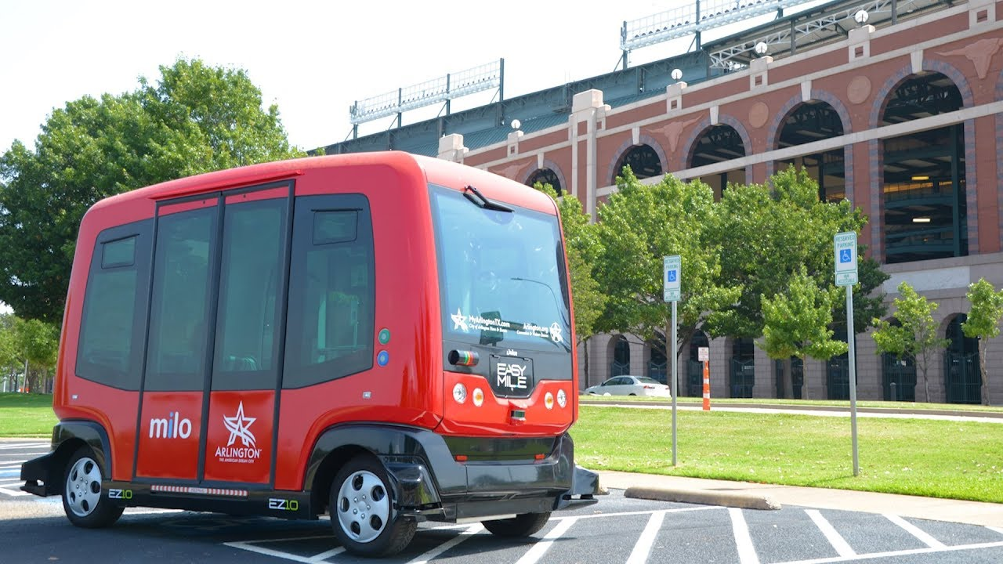
2017: EasyMile self-driving shuttles began shuttling passengers to Dallas Cowboys games in Arlington, Texas
Notes:
EasyMile autonomous shuttles have been deployed in Arlington, TX; Bishop Ranch, San Ramon, CA; Babcock Ranch, FL; Helsinki; Lausanne, Switzerland, etc.
Source: http://www.govtech.com/fs/Arlington-Texas-to-Launch-Nations-First-Autonomous-Public-Shuttle-Network.html

Slide 11
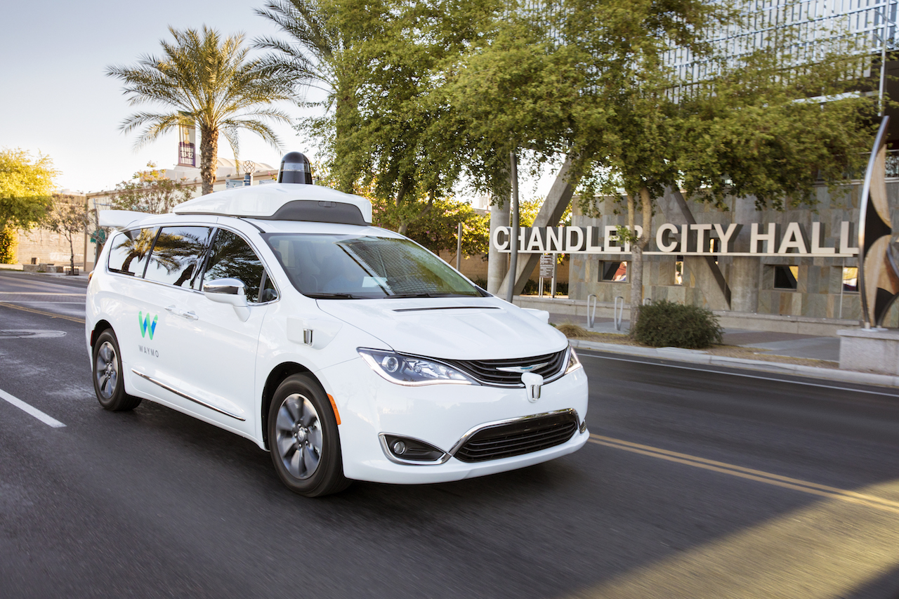
2017: Waymo self-driving vehicles, with no one in the driver’s seat, began operating on public streets in Chandler, AZ
2019: Waymo launched a limited self-driving taxi service,
with no backup driver, in Chandler & Phoenix.
Notes:
October 28, 2019: “Waymo tests 'rider only' service and looks beyond robo-taxis
DETROIT (Reuters) - Waymo Chief Executive John Krafcik said the self-driving vehicle company is now offering limited “rider-only” trips in Phoenix, Arizona, as it looks beyond the robo-taxis business to generate future revenue.
Waymo, a unit of Alphabet Inc, has begun offering fully automated rides, without attendants in the vehicle, to a few hundred early users of its robo-taxi service in Phoenix, Krafcik confirmed on Sunday at a dinner with journalists ahead of a conference in Detroit.”
https://www.reuters.com/article/us-autos-selfdriving-waymo/waymo-tests-rider-only-service-and-looks-beyond-robo-taxis-idUSKBN1X71U7?utm_source=applenews
April 13, 2018: “Waymo has been doing public road tests of no-driver cars in Arizona since October 2017, starting in Phoenix but with plans to expand. It has announced plans to start a driverless taxi service in Arizona this year.”
Source: https://www.sfchronicle.com/business/article/Exclusive-Waymo-appplies-for-no-driver-testing-12832425.php
November 7, 2017: “The company is now running its autonomous minivans around Phoenix with no human inside to grab the wheel if things go bad, CEO John Krafcik announced Tuesday…Once Waymo is up and running in Arizona, it will gradually expand its service area to cover a 600-square mile swath around Phoenix, Krafcik says.”
Source: https://www.wired.com/story/waymo-google-arizona-phoenix-driverless-self-driving-cars/

Slide 12
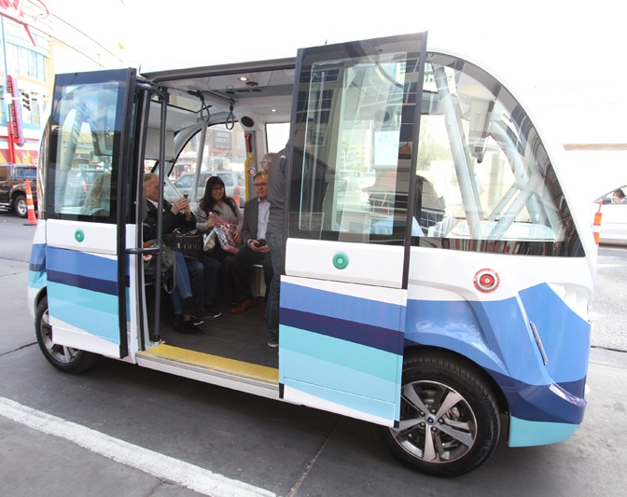
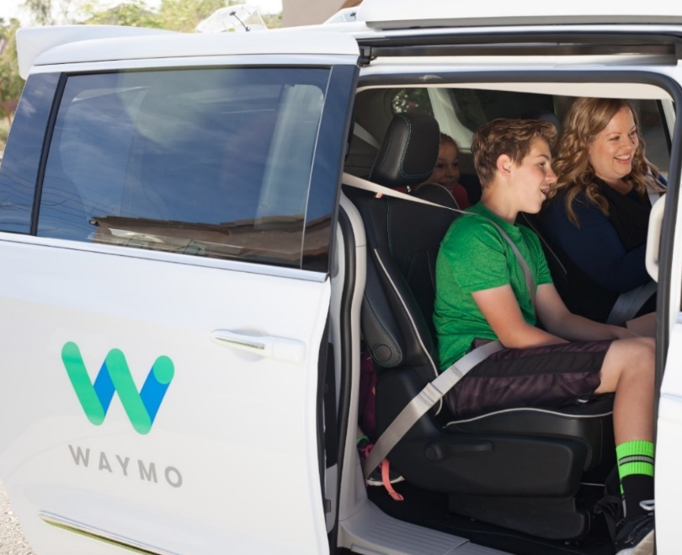
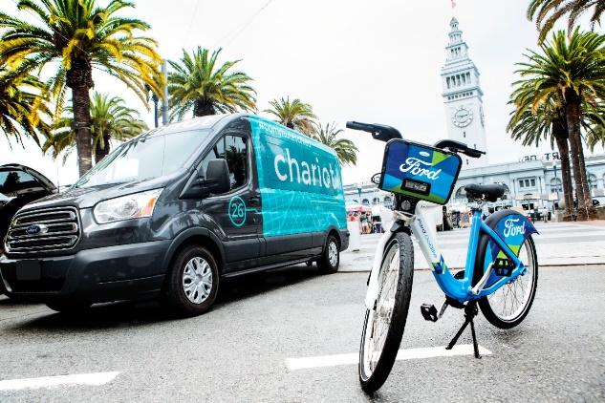


Ridehailing & self-driving vehicles are cutting parking demand
About 80% of the cost of transit is the driver.
Self-driving vehicles will cause the cost of transit & taxis to plummet.
No comparable breakthrough in parking costs is foreseen.
Notes:
No steering wheel, no pedals: #selfdriving shuttles now operating on CA public streets. About 80% of the cost of transit is the driver. Cost of transit in CA will soon plummet, but no breakthrough in #parking costs is foreseen. Still planning more parking?
^{http://abc7news.com/3183813/}
^{KEY FINDING #5}
New transportation technologies have the potential to impact parking demand.
The extent to which new transportation technologies, such as ride-hail services and autonomous vehicles (AVs), will change travel behavior and reduce parking demand over the long-term is unknown at this point. However, the rapid growth of Lyft and Uber and massive private investments in AV technology likely mean we will see more shifts in travel behavior in the coming years. If, as many analysts predict, AVs are heavily adopted as part of centrally owned and managed shuttle and taxi fleets, rather than as private mobility resources along the lines of how automobiles are used today, the future will see major drops in parking demand. The Downtown Specific Plan will need to factor this into considerations of how to manage parking and whether to build additional supply.

Slide 13
Now that ridehailing services and self-driving vehicles are reaching the streets, what will happen to parking demand?
EFFECT ON PARKING DEMAND?
Source | Estimate
Academic: Zhang et al | ~90% reduction 50% of fleet shared
OECD International Transport Forum | 80% reduction 100% of fleet shared
Academic: Kockelman | Each shared AV replaces 12 private vehicles
McKinsey | 5.7 billion square meter reduction in parking
Notes:
Modeled estimates of impact on parking demand:
80% reduction with 100% shared adoption (OECD)
90% reduction with 50% shared adoption (Zheng et al)
Lots of open questions

Slide 14
How should we reform parking & transportation policies today?

Slide 15
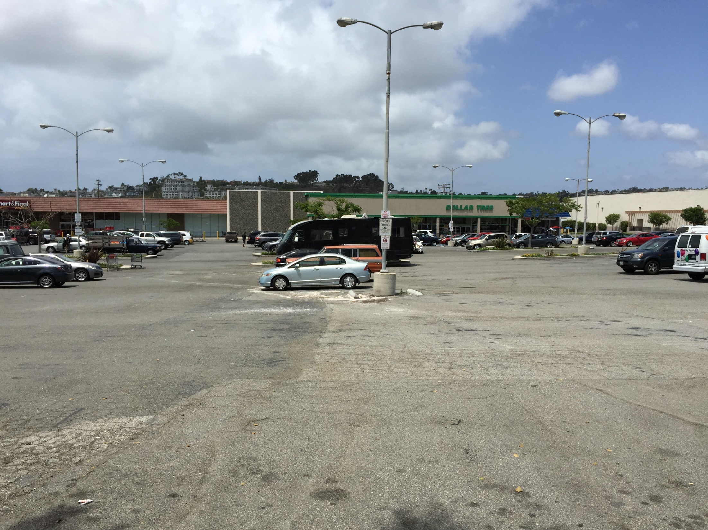
Definition: Minimum parking requirements are government regulations that specify the minimum number of parking spaces that must be provided for every land use.
They ensure that cities have more parking spaces than individuals would voluntarily supply.
Dana Point, CA, requires 4 spaces per 1000 square feet of built space for “multi-tenant general retail”
1.3 sq. ft. of asphalt per sq. ft. of building space
Notes:
Minimum parking regulations give us shopping areas that look this. It’s the landscape created by minimum parking requirements. Dana Point, California, zoning code requires 4 spaces per 1000 square feet for multi-tenant general retail with more than 25,000 square feet of space.
“Dana Point Municipal Code Chapter 9.35.080 Minimum Number of Required Parking Stalls.
General Retail:
Individual use on a separate lot: 1 stall/300 SF-GFA
Multi-tenant with less than 25,000 SF-GFA: 1 stall/220 SF-GFA¹
Multi-tenant with more than 25,000 SF-GFA: 1 stall/250 SF-GFA¹
¹ If restaurant space occupies more than 20% of the total GFA, or if an individual restaurant contains more than 2,000 SF, then additional parking stalls shall be provided for all restaurant space above the 20% or the 2,000 SF, whichever is greater. The additional parking shall be calculated at the applicable restaurant rate.” Source: http://www.danapoint.org/department/community-development/planning/planning-documents/zoning-code

Slide 16

What is the purpose of minimum parking requirements?
According to the zoning codes:
Palo Alto: “to alleviate traffic congestion”
Napa: “to reduce street congestion”
San Diego: “to reduce traffic congestion & improve air quality”
Walton County, FL: “reducing congestion to the public streets and promoting the safety and welfare of the public”
Generally, to prevent spillover parking problems
Notes:
Photo Credit: Patrick Siegman
Sources:
http://www.cityofpaloalto.org/civicax/filebank/documents/8694. Accessed October 21, 2017.
https://library.municode.com/ca/milpitas/codes/code_of_ordinances?nodeId=TITXIZOPLAN_CH10ZO_S53OREPARE_XI-10-53.11SHPA. Accessed October 21, 2017.
http://qcode.us/codes/napa/?view=desktop&topic=city_of_napa_municipal_code-17-17_54-17_54_040. Accessed October 21, 2017.
http://docs.sandiego.gov/municode/MuniCodeChapter14/Ch14Art02Division05.pdf. Accessed October 21, 2017.
https://www.co.walton.fl.us/DocumentCenter/View/3235/LDC-Chapter-5-Design-and-Development-Standards?bidId=. Accessed February 2, 2020.

Slide 17
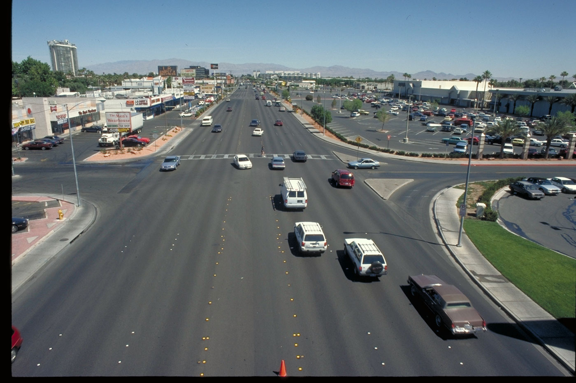
Minimum parking requirements are an economically illiterate theory for addressing traffic congestion
1. Set minimum parking regulations to ensure that virtually all destinations have excess spaces, even when parking is given away free, even at isolated locations with no transit.
2. Prohibit or discourage charging for parking.
3. Prohibit curb parking.
4. Convert curb parking into more traffic lanes.
Result: nobody circles in search of curb parking, more auto capacity…but there were unintended consequences
Notes:
In a landscape like this, nobody circles the block in search of free curb parking, no one going to these businesses will drive around the corner into a residential street and park in front of your house, and there are more traffic lanes. But, minimum parking requirements have had unintended consequences.

Slide 18
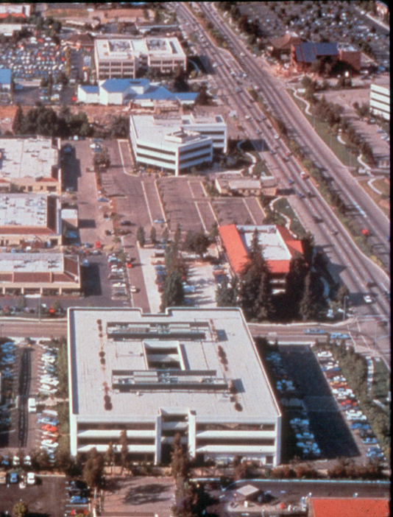
Minimum Parking Requirements - Source
Example: Office Parks
ITE Parking Generation Report
Peak Occupancy Rates, in spaces per 1000 sf of building area:
Lowest: 0.94 spaces
Average: 2.52 spaces
Highest: 4.25 spaces
Typical requirement:
4.0 spaces/1000 sf
Example: Walton County
Notes:
Photo Credit: Alex Maclean
Walton County, Florida, requires 4 spaces per 1000 ft.² of office space, just like many other cities throughout the nation. (Specifically, Walton County land development regulations require “1 parking space per 250 square feet of gross floor area” for “offices other than medical/dental offices“. Medical/dental offices require a minimum of “7 spaces per 1000 square feet of gross floor area”.
Source: https://www.co.walton.fl.us/DocumentCenter/View/3235/LDC-Chapter-5-Design-and-Development-Standards?bidId=. Accessed February 2, 2020.

Slide 19
What does it cost to increase parking supply?

Slide 20
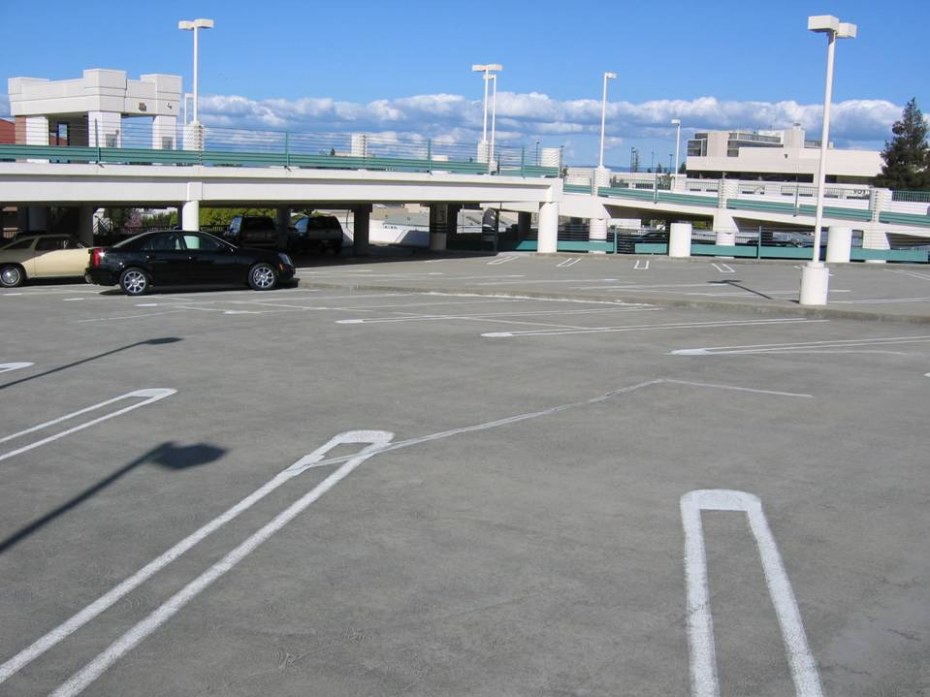
Cost per space gained
$50,000
$50,000
$50,000
$50,000
$50,000
$50,000
$50,000
$50,000
$50,000
$50,000
$50,000
$50,000
$50,000
$50,000
$50,000
$50,000
$50,000
$50,000
$50,000
$50,000
$50,000
$50,000
$50,000
$50,000
$50,000
$50,000
Photo & graphic concept by Dan Zack
Notes:
Parking is very, very expensive – $50k/space is typical in urban areas of California. In Walton County, Florida, construction costs are lower, so this cost may well be less.
And just because the top decks are rarely used (as evidenced by the lack of oil stains), it doesn’t mean that the spaces are free.

Slide 21
Option: Build more parking
How much revenue is needed to break even on the cost of building and operating a $50,000 parking space?
Notes:
We have established that we need to figure out a way to ensure that the parking program is self-sufficient – that we aren’t using limited general fund dollars to pay for our parking system when we have so many other priorities (education and public safety, just to name two very important ones)
If we wanted to build parking – what would it take to ensure that it wouldn’t be a further drain on our general fund?

Slide 22
Cost per space gained
$335/month
$335/month
$335/month
$335/month
$335/month
$335/month
$335/month
$335/month
$335/month
$335/month
$335/month
$335/month
$335/month
$335/month
$335/month
$335/month
$335/month
$335/month
$335/month
$335/month
$335/month
$335/month
$335/month
$335/month
$335/month
Anything a community can do to reduce parking demand for less than $335/month/space is a bargain
$335/month
Photo & graphic concept by Dan Zack
Notes:
It would cost $335/month, every single month for the expected 35-year useful lifetime of the parking garage, to recoup the costs of building and maintaining a new parking garage. However, here in Walton County, new garages are only needed during the peak season. If new garages are used for only 3 months out of the year, then the cost per space per month is actually four times higher. That’s more than $1200 per parking space per month, every single month for the expected 35-year useful lifetime of the new garage.

Slide 23
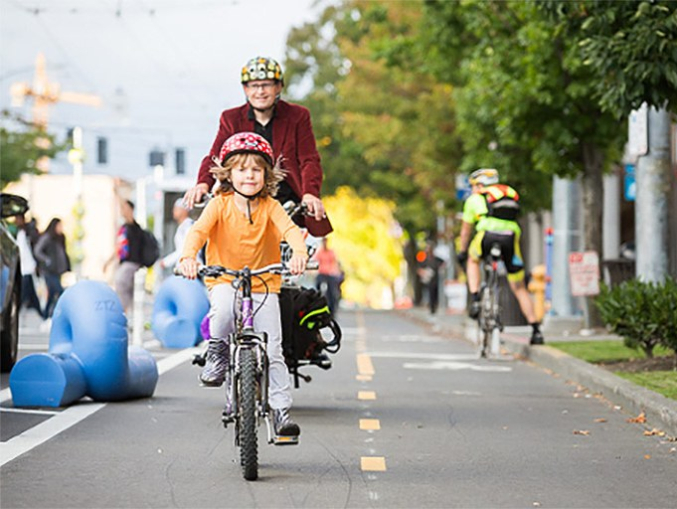
Unintended consequences: higher rents
Analysis of 23 recently completed Seattle-area multifamily housing developments:
parking subsidies increase monthly rents approximately 15% or $246 per month for each occupied unit
approximately 20% of occupants own no motor vehicles
during peak periods 37% of parking spaces are unoccupied
Source: London and Williams-Derry. Who Pays for Parking? How The Oversupply Of Parking Undermines Housing Affordability. 2013. www.sightline.org/research/who-pays-for-parking. /

Slide 24
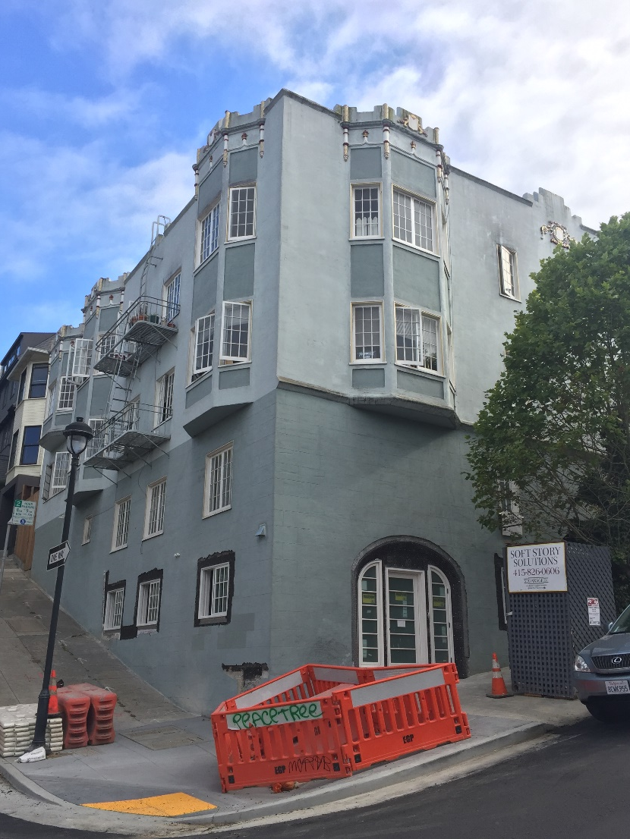
Unintended consequences: fewer can afford to buy
San Francisco study of the effect of code-required parking on housing affordability:
Code-required parking increased home prices
24% more households could afford houses if they did not include parking
20% more households could qualify for loans on condominiums without parking
Source: Jia and Wachs. Parking Requirements and Housing Affordability: A Case Study of San Francisco, 1998.

Slide 25
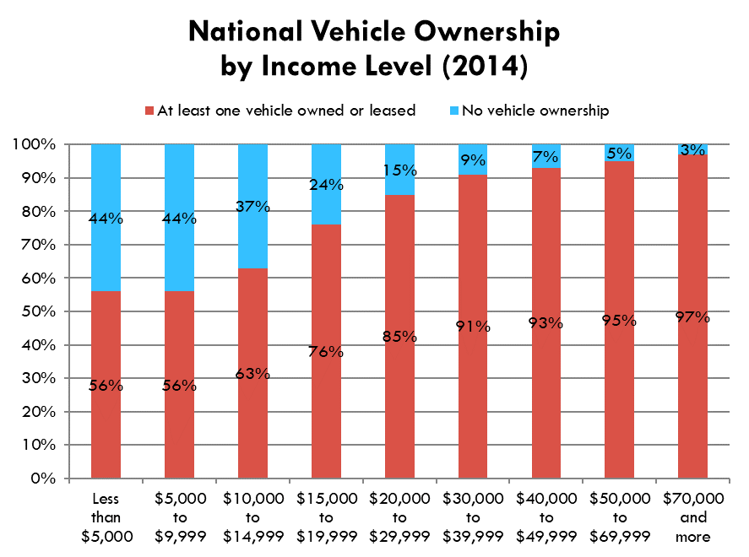
Addressing social equity. Example: housing
Should cities subsidize housing for cars, or for people?
Housing is a basic human need.
Parking subsidies are a matching grant program. Only those who can afford a car or choose to own one can qualify.
The wealthy own more vehicles per household, drive more and park more than the poor. Wealthy people benefit disproportionately from parking subsidies.
Source: U.S. Department of Labor, Bureau of Labor Statistics, Consumer Expenditure Survey, 2014
Notes:
Housing is a basic human need. Everybody needs a roof over their head.
When I was a college student, I was able to afford to buy a $500 car. My friend Sebastian couldn’t afford one. So my university spent the equivalent of $50,000 in today’s money to provide me with a free parking space at my dorm. My friend Sebastian got nothing. That didn’t improve social equity. It made inequality worse. It’s better to prioritize assisting people with their basic human needs, like housing, instead of subsidizing parking.

Slide 26
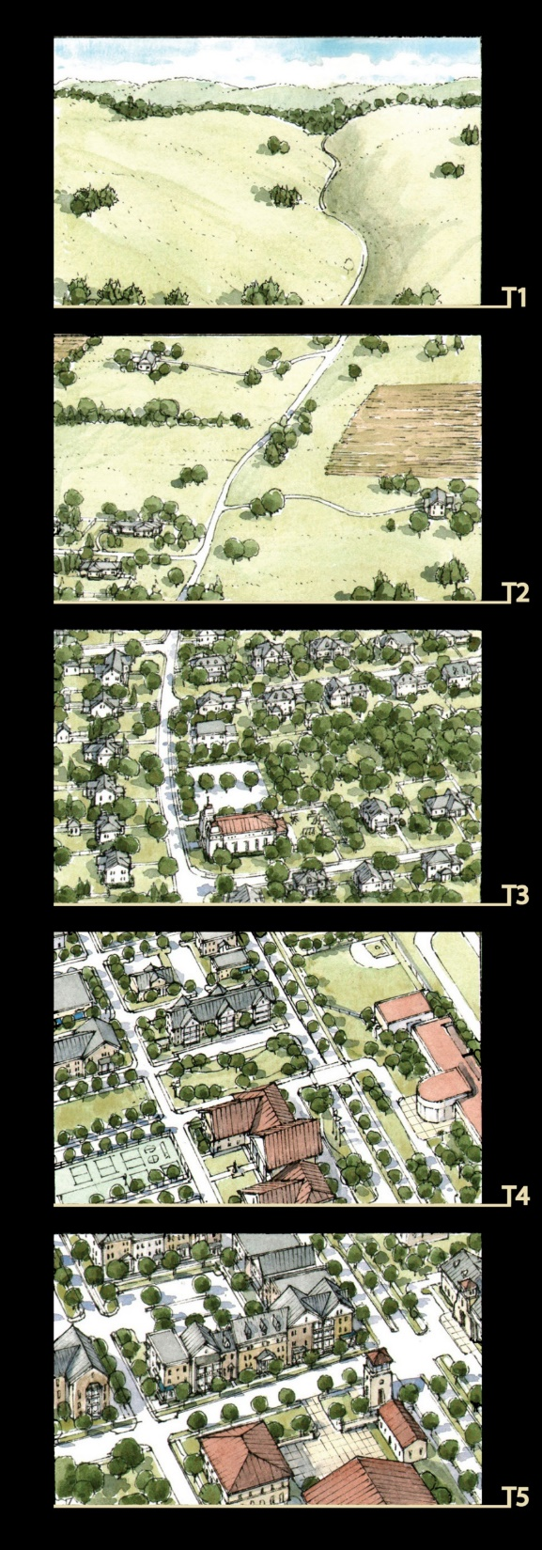
Three Parking Policy Reforms
Charge the right prices for curb parking
Return the parking revenue to the blocks where it is generated, to pay for public services
Remove minimum parking requirements
Image: Christopher Illustrations
Notes:
If curb parking is managed properly, minimum parking regulations can be removed citywide, even if no transit exists.
“Our parking policies are messed up, big time, and they have messed up our transportation system, our cities, our environment, and our economy. The costs are often hidden and hard to trace to parking policies, but the damage is hard to overestimate. Nevertheless, there is a bright side to this mess: better policies can produce enormous improvements. We can stop doing harm, and start doing some good for cities, the environment, and the economy. Here are three recommended reforms.
Each one of these three is the exact opposite of what we are now doing. Most curb parking is free, the paltry revenue we collect goes into the general fund, and we require off-street parking for every land use. But cities have dramatically changed courses before. Highrise public housing projects were once state-of-the-art, but many cities have demolished them. Urban renewal was once the best hope of downtowns, but most cities have abandoned it in favor of historic preservation. Similarly, some cities have shifted from minimum parking requirements to parking caps, and other cities may follow. We do eventually recognize our mistakes, and we may some day condemn off-street parking requirements just as we now condemn the public housing and urban renewal disasters of the 20th century. I hope so.” – Donald Shoup

Slide 27
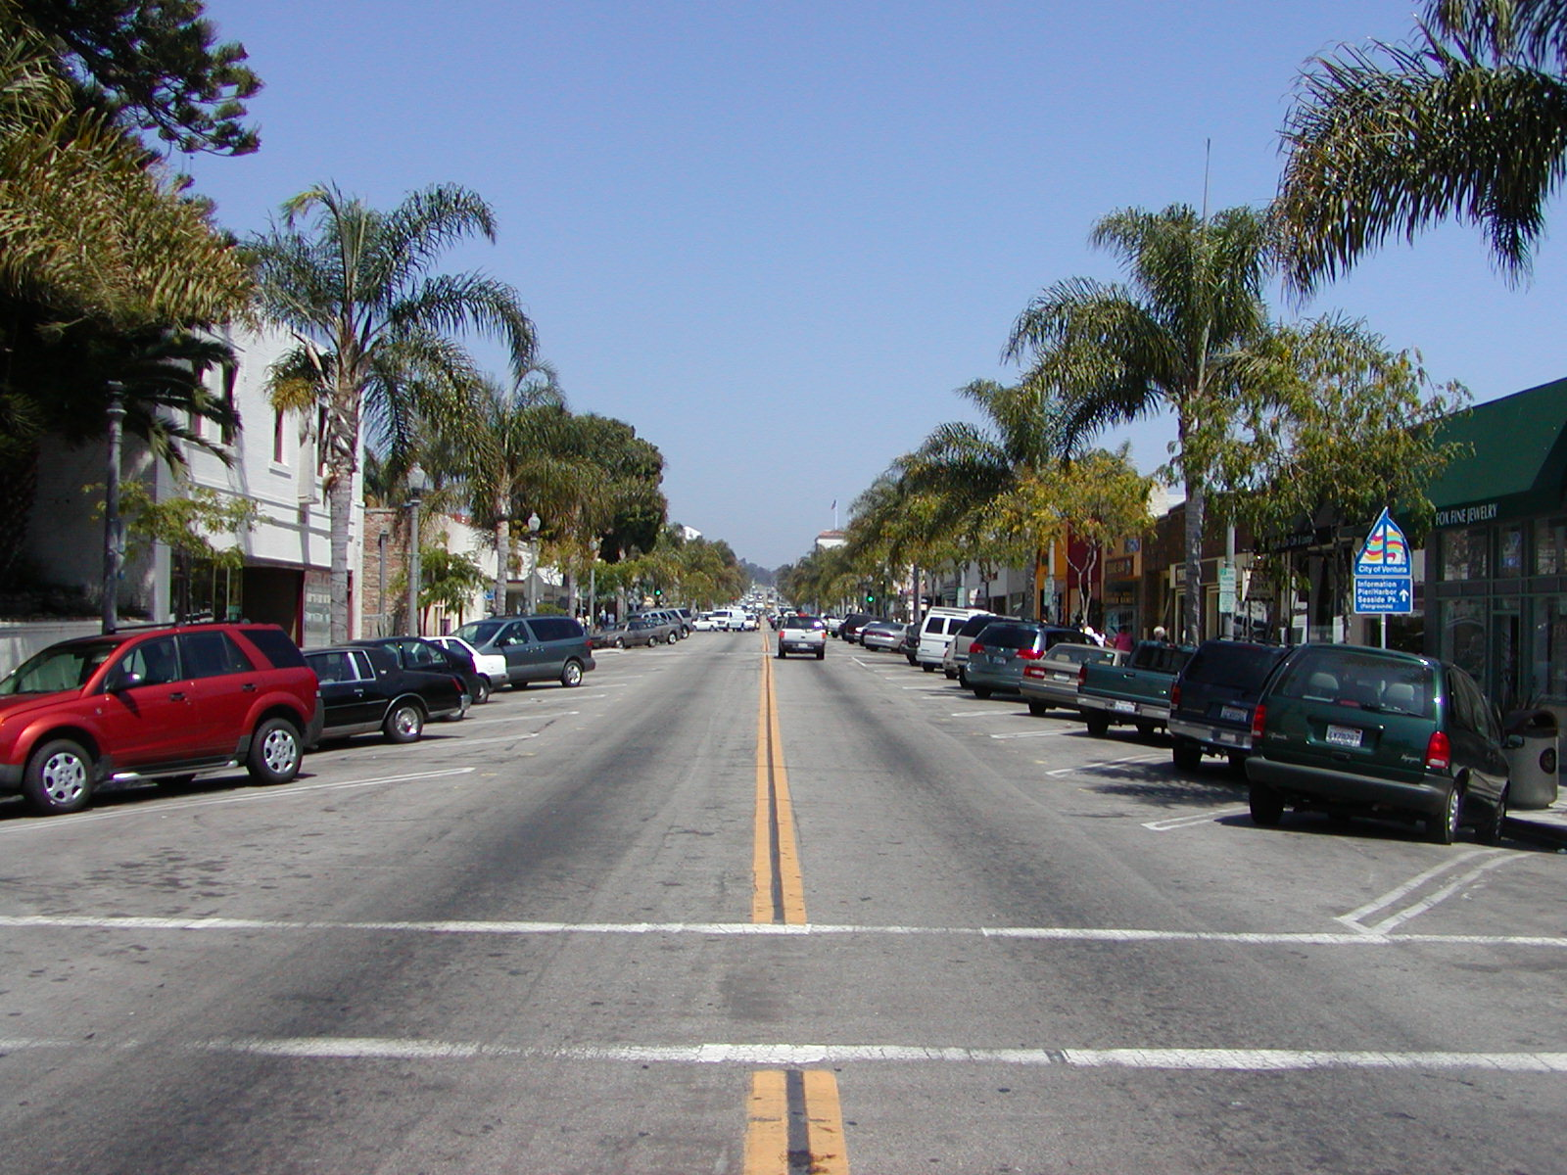
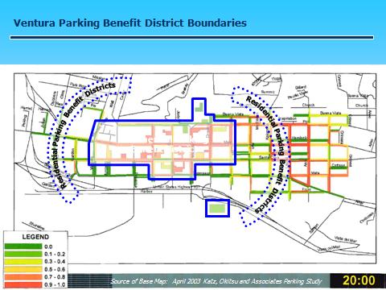
Strategy: Parking Benefit District
Charge the right prices for curb parking.
Ventura charges the lowest price needed to achieve 65% to 85% occupancy on each block
No time limits!
Current rates: $0.50 - $1/hour
Current hours: 10am - 9pm, daily
Notes:
Another example – a city a bit more like ours, Ventura
Only installed meters on the few blocks where parking was reliability a big pain (like us – only a portion of their downtown had really difficult parking conditions)
Used performance-based pricing
Took off time limits – again, if there are one or two spaces available, it doesn’t really matter how long your neighbor has been there
For more info: http://www.cityofventura.net/pw/transportation/parking

Slide 28
Strategy: Parking Benefit District
Return the parking revenue to the blocks where it is generated, to pay for public services
  Ventura’s revenue: $530,000 annually from 318 meters
  Funds new police officer & 9 police cadets, better lighting, free public Wi-Fi
  Crime down 40%
Notes:
Results
Still pretty modest parking fees
Meters run throughout the period in which there’s a good amount of demand – 10 a.m.-9 p.m.
Raises a good amount of revenue, which can only be used to improve downtown
One thing they used money for – additional police officer and cadets, and their presence in turn reduced crime significantly
From the website (for reference only)
All net revenue generated from the pay stations is directed back into the Downtown and can be spent on the following:
Enhanced Police Services
Increased Maintenance
Landscaping
Parking equipment
Parking structures
Pedestrian linkages
Street furniture
Street cleaning
Transportation & parking planning
Transportation & parking marketing and education programs
Wayfinding system
Universal Valet programs

Slide 29
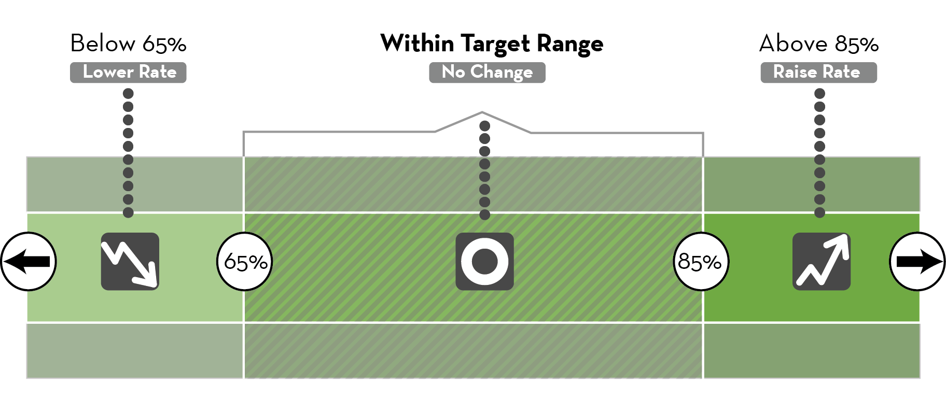
Performance-Based Pricing at Work
SDOT (2014) Annual Paid Parking Report
Notes:
Performance-based pricing –
Set a performance target: Aim to have one or two spots per block available at all times (65-85% occupancy)
Adjust prices regularly (monthly, quarterly) to get occupancy into the target range – lower prices when occupancy is lower than 65% to encourage people to park there, raise prices when occ is above 85% to discourage one or two people from parking there
Gradual adjustments only – max of $.25 during price changes (or no change in price if not needed

Slide 30

Parking Management That Actually Manages Parking
Tuesday, September 14, 2010
“At about 10:30 this morning, I step out of my office…Almost immediately, I notice something different…
The paid parking portion of our downtown parking management program had gone into effect at 10 a.m., and it was already showing results. People who park all day downtown have moved into the lots and the upper levels of the parking garage. Spaces on the street are now available for shoppers, diners, and others who were running short-term errands. In other words, only 30 minutes after we instituted the parking management program, it is working.”
-- Bill Fulton, Mayor of Ventura
Source: http://fulton4ventura.blogspot.com/search?updated-max=2010-09-22T13%3A47%3A00-07%3A00&max-results=7
Notes:
Ventura’s mayor had immediate praise for the change
ORIGINAL STORY (for reference only)
Tuesday, September 14, 2010
Parking Management That Actually Manages Parking
At about 10:30 this morning, I step out of my office at the corner of Poli and Oak and walk down Oak Street to get a cup of coffee at Palermo. Almost immediately, I notice something different.
The parking lot on Oak Street, usually two-thirds empty in the morning, is mostly full. And the on-street parking spaces along Oak and Main Street, which are mostly occupied on a typical morning at this time, are mostly vacant.
It takes me a moment before I realized why: The paid parking portion of our downtown parking management program had gone into effect at 10 a.m., and it was already showing results. People who park all day downtown have moved into the lots and the upper levels of the parking garage. Spaces on the street are now available for shoppers, diners, and others who were running short-term errands. In other words, only 30 minutes after we instituted the parking management program, it is working.
In all the discussions around town this summer about paid parking, the emphasis has always been on the "paid" part. Why is the city charging for parking downtown? Are we just being greedy? Where will the money go? Why would anyone go downtown if they have to pay to park?
These are all fair questions. (And they all have good answers -- for example, all the parking revenue money is going to benefit downtown and not being spent elsewhere in the city.) But the questions have obscured an important goal of the paid parking, which has nothing to do with revenue. The goal is to encourage employees and other long-term parkers downtown in order to free up space on the street for shoppers. And I was stunned at how quickly our "parking management" goal was achieved.
All day, we have a dozen or so police officers, public works officials, police cadets, and police volunteers downtown assisting people. When I go out again at lunchtime, the street spaces are beginning to fill up -- and everywhere I look, somebody from the city is helping a downtown shopper figure out how to use the new machines. But the point is still clear: The on-street spaces are gradually filling up with people who had come downtown to shop.
In the months leading up to the inauguration of paid parking, I kept hearing stories about how downtown employees were hogging the onstreet spaces. I heard that some merchants told their employees to park on the street -- but a block away, so as not to take up parking in front of the store. I heard that some businesses and employees erase the chalk marks that our parking enforcement folks put on their tires. I heard that some business owners give their employees a few minutes off every two hours to move their cars.
Frankly, I wasn't sure if I believed all these stories. After all, why would any merchant park in front of their own store? Why would you deal with all the hassles to park on the street -- erasing chalk, moving cars -- when there's free parking in city lots a half-block away? It seemed ridiculous to me. But the lesson from today is that it's not ridiculous. Obviously, what's been happening is that employees have been parking on the street and now they are parking in the lots.
At about 3 pm, I decide it is time for another cup of coffee at Palermo, partly just to see what was going on. By now most of the onstreet spaces are taken -- but the police volunteers and cadets are still around. A woman wanderes past Palermo and asks me if I know how to use the machines. I start to help her (she seems tickled pink that the mayor is helping her) when a fresh-faced police cadet comes up and does a better job of explaining it.
Anybody's first impulse, I think, is that paying for parking is a bad thing. But upon reflection, a lot of folks -- merchants and shoppers alike -- have come around to the idea that it can be a good thing.
Some shoppers have complained over the past few months that parking at the mall is free, so why should they pay to park downtown? The answer -- provided by Downtown Ventura Organization board chair Dave Armstrong -- is that you're paying for access to a few hundred premium spaces. And he's right. After all, all the mall parking spaces are far away from the stores -- farther than even the most remote free lot downtown. If it was possible to drive right inside the mall and park in front of your favorite store, don't you think the mall would charge for that space? And don't you think some people who think it's worth it would pay the price? Obviously, the answer to both these questions is yes.
Similarly, Main Street merchants have come to see that paid parking can help them too by opening up short-term spaces close to their store. As the owner of Jersey Mike's told me today, her customers used to have to circle the block three times looking for a space or park in a faraway parking lot. Now they can park right in front of her shop for a quarter -- or a dime -- or a nickel -- while they pick up their order. Because even though it's $1 for the first hour, you can buy less time with coins. And there's less traffic on the street because there's less "cruising" for a parking space.
6 pm: I head out to one our local establishments. Now it's very busy downtown -- the younger crowd is beginning to head out to downtown -- and the onstreet spaces are still mostly full. Prime time downtown.
Some people who grumbled about this idea pointed to the experience this summer at Ventura Harbor: Paid parking was instituted in the prime lot near the Village on weekends. But, the complainers pointed out, the Harbor ended the program early because they didn't achieve their revenue goals. True enough, but it was a gloomy summer and tourist business was off generally. And what the complainers tend to overlook is the fact that the Harbor actually did meet the parking management goals. Employees and all-day parkers going to the Channel Islands parked elsewhere, freeing up plenty of space for peope shopping at the Village. In that sense, it was a success.
9:15 pm. I take one final swing through downtown. Parking on the street is fairly light now -- especially on California between Santa Clara and Thompson (near the garage) and on other side streets such as Oak. And it's a fairly quiet Tuesday night -- most places. I peek into Anacapa Brewing to talk to owner Danny Saldana -- and, to my amazement, the place is completely full. Danny is happy with the situation and, like many other downtown business owners, says he is providing one-hour parking coupons to his regular customers for free. It's well worth it, he says, to keep them coming.
I walk back up Oak Street toward the office. The spaces on the street are mostly empty. And the parking lot across from office -- usually almost empty by now -- is completely full. Eleven hours later and it's still working.
Labels: Downtown, Parking, Smart Growth
Source: http://fulton4ventura.blogspot.com/search?updated-max=2010-09-22T13%3A47%3A00-07%3A00&max-results=7

Slide 31
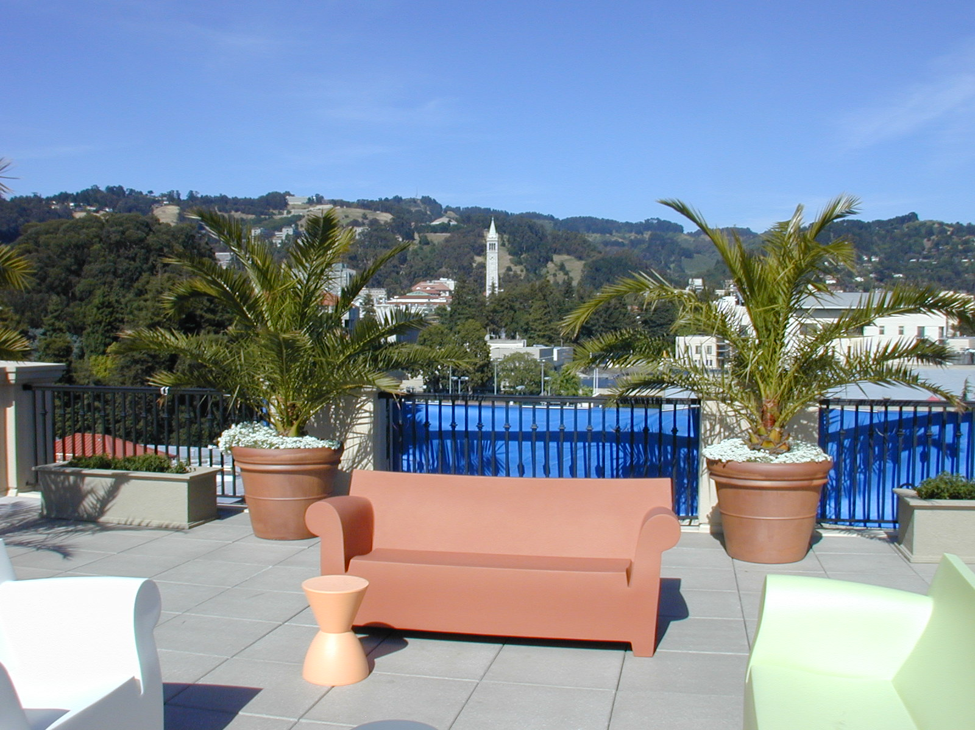
Example: The Gaia Building, Berkeley, CA
Managing curb parking eases removal of minimum parking regulations & unbundling of parking costs
Notes:
Photo Credit: Patrick Siegman
Unit types: 1 studio, a bunch of 1 BR's, a bunch of 2 BR's. The top floor has the larger loft apartments. These are the only 2-level apartments in the building. Unit sizes start about 600 s.f., some around 700 s.f., go up to 1300 s.f. for the lofts. There is flexible theatre space (for the “Shotgun Players”) set up as 'black box' space. There is also a cafe. Mezzanine floor overlooking the theatre will be the theater groups' offices. Apartment rents are $1300 to $1900 for the market rate apartments. These are high, in order to support the required below-market rents. Tenants: About half of the tenants are Berkeley students, who turn over fairly rapidly as they graduate. Another 20% or so are the low-income tenants, who generally don't own cars. A certain share of tenants -- the luxury class folks -- definitely want to rent a parking space, and so it's good to have the spaces available. One can't do residential infill housing with more than 1 space per unit required, Kennedy says. It is just not possible to get sufficient unit density to pay the costs.

Slide 32
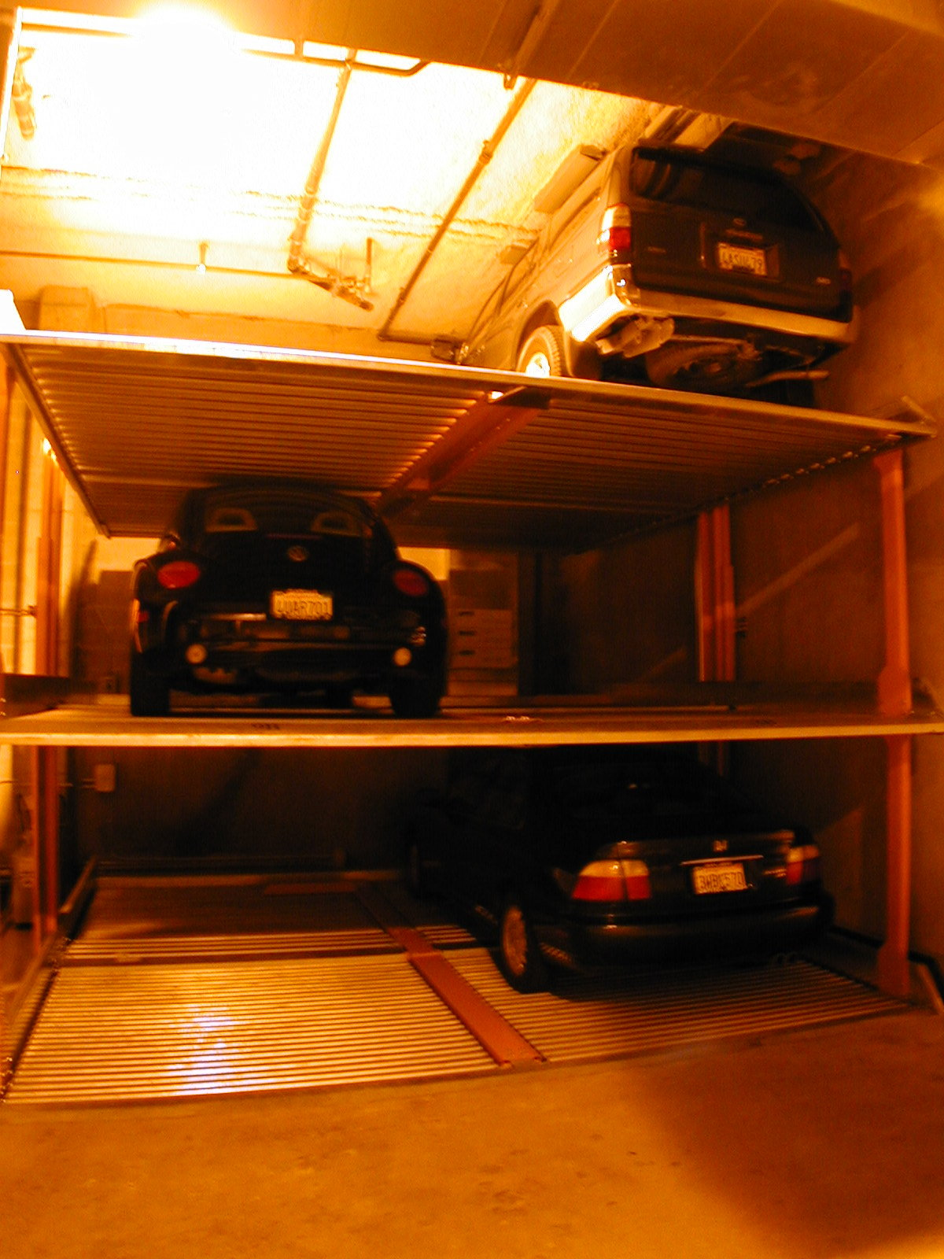
Berkeley requires unbundling of parking costs from housing costs
Parking fee: $150/month
Notes:
Photo Credit: Patrick Siegman
Source: Berkeley Municipal Code Section 23E.68.080 Parking -- Number of Spaces
G. For any new building with residential units or structures converted to a residential use, required parking spaces shall be leased or sold separate from the rental or purchase of dwelling units for the life of the dwelling unit, unless the Board grants a Use Permit to waive this requirement for projects which include financing for affordable housing subject to the finding in section 23E.68.090.I.
Garage level: - Klaus stacked parking lift system is placed in the rear of the ground floor of the building. These are triple lifts, with a cost of $12,000 per space, including the cost of digging the pit for each lift, and installing the lift. The pit is approximately 5'6" deep, while the ceiling height for each triple lift is 18'. This allows for two cars of approximately 5'6" height in the two lower bays of the lift, and sport utility vehicles of greater height (up to about 7' to 8' height) in the top bay. 18' is also an excellent height for charming first-floor retail and cafe spaces, so this building , where the first level consists partly of high ceiling theater space, partly of mezzanine level, dividing the floor into two 9' height levels, and the rear portion of the building devoted to the garage and parking lifts, is a wonderful model. There are 42 parking spaces for the 91 residential units, the ground floor theater and cafe, the theater group's office space, and the top floor Panoramic Interests' penthouse office with its employees (at least 4 employees on site). - Price: Parking is rented as a separate amenity, for $150/month/space. Market rate in downtown Berkeley is about the same, though one nearby garage is now charging $200 per month. Note that this is about covers the cost for typical structured parking, by my calculations. Currently, they don't rent spaces to any outside tenants, but they'll consider it after seeing the demand from this new year's crop of tenants. - Demand: only 20 parking spaces are in use.

Slide 33
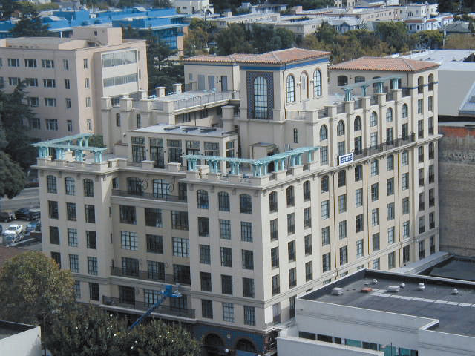
Managing curb parking + removing minimum parking regulations + unbundling parking costs = greater affordability
Berkeley requires
Unbundling of parking costs from rents
Provision of spaces for carshare cars
Free transit passes
Example: Gaia Building
$150/month per space
91 apartments, theater, café & office space
42 parking spaces built
Result: 237 adult residents with just 20 cars
Notes:
There are 42 parking spaces for the 91 residential units, the ground floor theater and cafe, the theater group's office space, and the top floor Panoramic Interests' penthouse office with its employees (at least 4 employees on site). - Price: Parking is rented as a separate amenity, for $150/month/space. Market rate in downtown Berkeley is about the same, though one nearby garage is now charging $200 per month. Note that this is about covers the cost for typical structured parking, by my calculations. Currently, they don't rent spaces to any outside tenants, but they'll consider it after seeing the demand from this new year's crop of tenants. Demand: 237 residents, but only 20 parking spaces are in use. One can't do residential infill housing with more than 1 space per unit required, Kennedy says. It is just not possible to get sufficient unit density to pay the costs. Electric Vehicles: 3 neighborhood electric vehicles from GEM (Global Electric Motors, I think) are kept on the top level of one parking lift, using up just two car spaces. One is a four-seater, another is set up as a service vehicle with a pick-up truck style cargo bed.

Slide 34
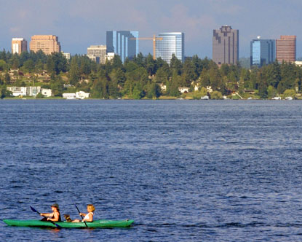
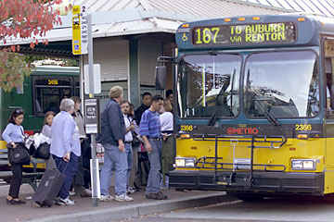
Solution: Unbundle parking costs from commercial leases
Example: Downtown Bellevue, WA
Building owners must lease parking separately from office space
Minimum price for monthly parking ≥ the price of a two-zone bus pass
Minimum rate in 2017: $135/month
Maximum parking requirements: 2.4 spaces / 1000 sf GLA
Results: drive alone commute rate fell by 30%, from 81% driving alone to 57%
Notes:
Maximum parking requirements: 2.4 spaces / 1000 sf of usable space for non-residential buildings, max 2 spaces per unit for residential
See TCRP Report 95, Ch. 18, page 18-11 and other pages. Drive alone commute rate fell by 30%, from 81% driving alone to 57% - this was from 1990 to 2000.
Price of a 2-zone bus pass on Sound Transit express buses in 2017 was $135/month. Adult multi-county fare (= 2-zone fare) = $3.75, per https://www.soundtransit.org/Fares-and-Passes/ST-Express-bus-fares. The corresponding one-month pass price for a $3.75 per trip fare was $135/month, per https://www.soundtransit.org/Fares-and-Passes/orca-card.
City of Bellevue, Washington City Code Chapter 14.60 TRANSPORTATION DEVELOPMENT CODE
Source: https://www.codepublishing.com/WA/Bellevue/html/Bellevue14/Bellevue1460.html#14.60.080
Sections included below: 14.60.080 Transportation Management Program – Downtown
14.60.080 Transportation management program – Downtown.
A. The director may require a transportation management program (TMP) for any project proposed within the downtown in order to reduce congestion, reduce peak hour trips, or implement the policies of the comprehensive plan.
B. Programmatic Requirements.
1. The owner of a building with 50,000 gross square feet or more of office shall, in addition to the programmatic elements identified in the Transportation Management Requirement Chart in BCC 14.60.070(F), perform or cause to be performed the following elements:
a. Commuting options information boards for each tenant with 50 or more employees.
b. Leases in which the tenants are required to participate in periodic employee surveys.
c. Identification of parking cost as a separate line item in such leases and a minimum rate for monthly long-term parking, not less than the cost of a current Metro two-zone pass.
d. A personalized ridematching service for building employees to encourage carpool and vanpool formation. The ridematching service must enhance the computerized ridematching service available from Metro (or a comparable service), with personalized follow-up with individual employees.
2. Duration. The programmatic requirements shall continue for the life of the building.
C. Performance Goals.
1. The owner of a building with 50,000 gross square feet or more of office shall, as part of the TMP for the building, comply with the following performance goals:
a. For every other year beginning with the building’s first certificate of occupancy (CO) anniversary and for 10 years thereafter, the performance goals shall become more restrictive, so that by the tenth year the maximum SOV rate will be reduced by 35 percent from the CO year baseline.
b. The city may adjust the above rates every other year based on review of current conditions in the downtown, the characteristics of the building, and other local or state regulations.
c. These performance goals apply to present and future property owners for the life of the building.
D. Survey and Analysis Requirements.
1. Employee Survey. The property owner shall conduct a survey to determine the employee mode split. The survey must be conducted by an independent agent approved by the city. This survey shall be conducted in a manner to produce a 70 percent response rate and shall be representative of the employee population. If the response rate is less than 70 percent, all nonresponses up to 70 percent shall be considered SOV trips. The survey results shall be used as the basis for calculating performance levels. The city shall provide a survey form to the property owner.
2. Schedule of Survey. The survey is to be conducted every two years; the first survey shall be conducted one year after the issuance of the CO.
3. Analysis of Performance Goals.
a. Single-Occupancy Vehicle Use Formula:
(NS/NT)(100) = percent SOV use, where:
NS = number of employees who commute to work by SOV
NT = total number of employees.
E. Reporting Requirements.
1. Content of Evaluation Report. The property owner shall submit a report to the city which includes the following elements:
a. The property owner’s compliance with the performance goals listed in subsection C of this section, including the number of HOV spaces, their location, how HOV spaces are monitored, loading and van parking locations, transportation coordinator activities, the number and location of commuter information centers and employer commuter options boards, an example of lease language, past and current parking costs and ridematch activities.
b. The results of the employee survey, including the survey procedures and the percent SOV use by employees.
c. Any nonrequired activities undertaken by the property owner to encourage HOV and transit use or any unusual circumstances which have affected SOV use.
The city will provide a report form to the property owner.
2. Reporting Schedule. An initial action plan for implementing the TMP shall be submitted within six months of the issuance of the temporary certificate of occupancy. The action plan shall describe transportation management techniques that the property owner will use to encourage HOV use by employees and reduce peak period vehicle trips as necessary to meet the performance goals. City staff will be available to assist in the development of the action plan. The evaluation reports shall occur by building’s first CO anniversary, and every two years thereafter.
F. Failure to Meet Performance Goals.
1. Remedies. If the city determines that the property owner has failed to meet the performance goals of subsection C of this section, the property owner shall comply with the action plan, employee survey and reporting requirements as set forth below.
2. Action Plan Requirement.
a. Plan Required. If the property owner fails to meet the performance goals, the property owner shall prepare, submit to the city and implement an action plan to meet the performance goals within one year.
b. Adequacy of Plan. The property owner will be allowed flexibility in developing the action plan subject to city review and approval, which approval shall not be unreasonably withheld. As a guide to this review, the city will evaluate the following:
i. The relationship of the number of employees that would be affected by the plan actions to the size of the deficiency which must be reduced.
ii. The effectiveness of proposed actions as they have been applied elsewhere in comparable settings.
iii. The schedule for implementation of the action plan and the assignment of responsibilities for each task.
3. Annual Employee Survey Requirements. An employee survey shall be conducted within one year of the date of submission of the previous report to the city. This survey shall be conducted under the same conditions and using the same methods as described in subsection (D)(1) of this section.
4. Annual Report Requirement. A report shall be submitted one year after the submission of the previous report. The report shall include all of the contents described in subsection (E)(1) of this section, and in addition shall include descriptions of:
a. Implementation of the action plan, including expenditures; and
b. Summary of effectiveness of elements of the action plan.
5. Duration. The property owner shall comply with the action plan, the annual survey and the annual report requirements every year that the property owner fails to meet the performance goals up to a maximum of six years after submission of the first report.
6. Assurance Device. In the event of a failure by the property owner to meet the performance goals, the property owner shall provide to the city an assurance bond, or other assurance device referenced in BCC 14.60.021(C), at the property owner’s option, securing any financial incentives prescribed in an action plan. The assurance device shall equal the cost of the maximum incentive levels which could be required for the following year as referenced in the action plan. The amount of the assurance device shall be determined when the level of activity is determined on the action plan. The assurance device shall be issued not later than 60 days after this determination.
G. Violations. The property owner shall be in violation of the requirements of this section if he/she fails to:
1. Comply with the programmatic requirements of subsection (B)(1) of this section; or
2. Comply with the reporting requirements of subsection E of this section; or
3. Submit the required action plans required in subsection (F)(2) of this section; or
4. Implement the required action plans required in subsection (F)(2) of this section; or
5. Conduct the required employee survey of subsection (F)(3) of this section. (Ord. 6181 § 2, 2014.)

Slide 35
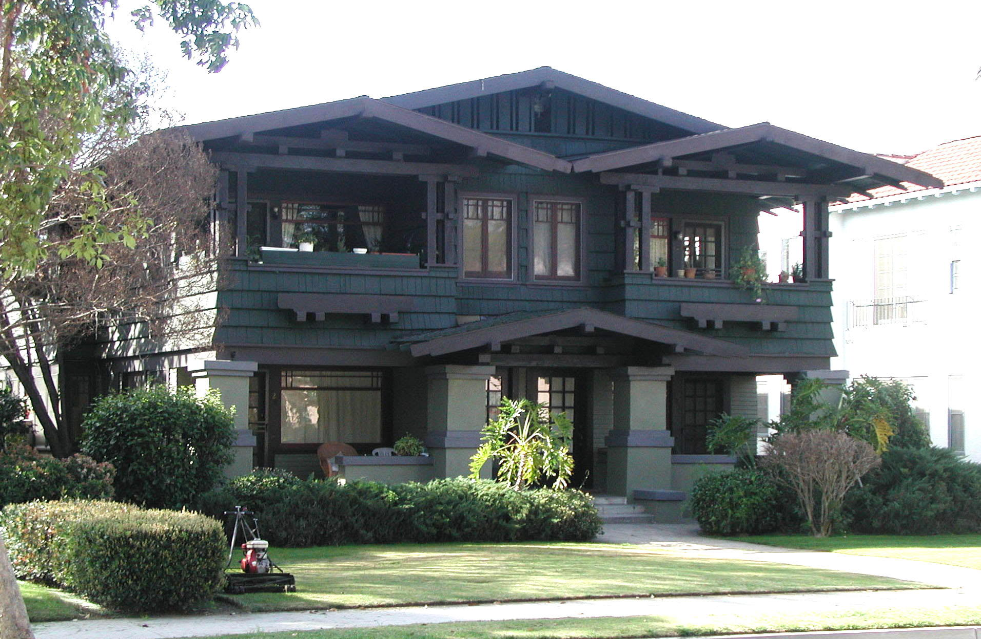
Managing curb parking in residential areas
Moule & Polyzoides
ARCHITECTS AND URBANISTS
Fourplex
Photo: Moule & Polyzoides

Slide 36
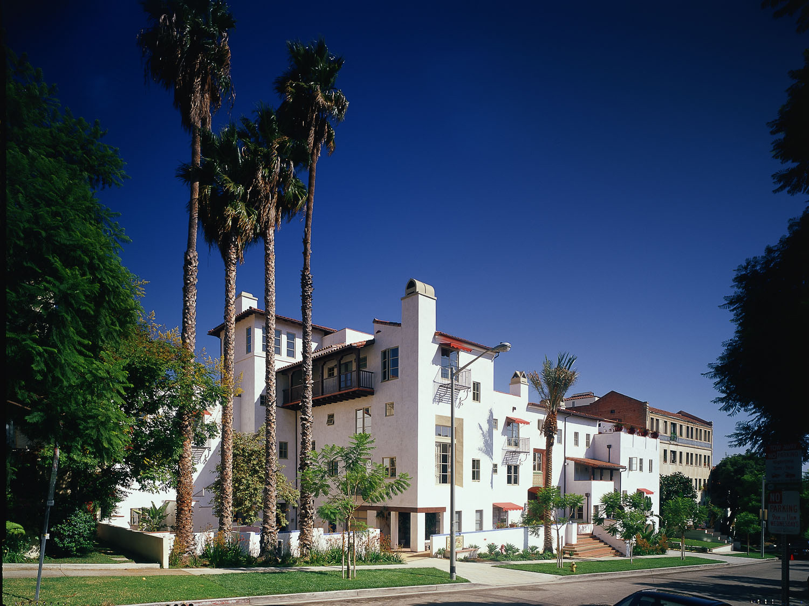
Courtyard Apartments
Moule & Polyzoides
ARCHITECTS AND URBANISTS

Slide 37
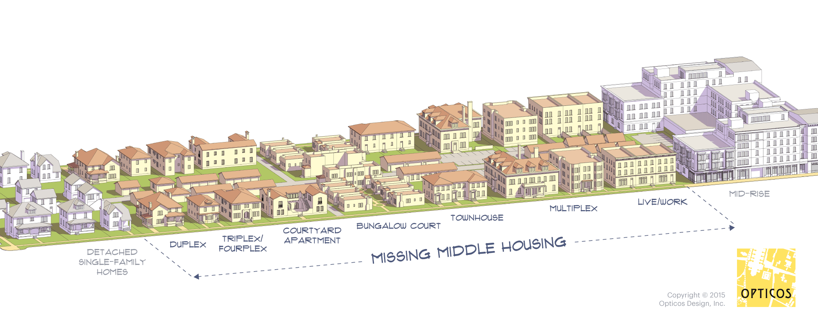
Want to allow Missing Middle Housing?
Learn to manage curb parking well.
Issue no more than one curb permit per curb parking space
Example: Tucson issues no more than 1 permit for every 1 curb space on a property’s frontage

Slide 38
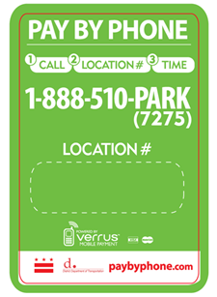
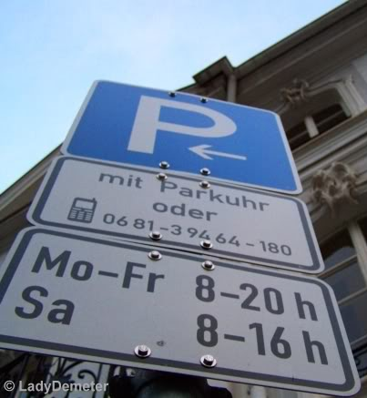
Residential Parking Benefit Districts
Charge non-residents & future residents the right prices for curb parking
Return the revenue to the neighborhood to pay for public services
Let existing residents park free or cheaply
  Limit # of curb permits issued to less than the # of curb spaces
Remove minimum parking regulations
Example: Laguna Beach, CA
Non-residents pay $1-$3/hour
Residents pay $40 per year
Photos: Lady Demeter, Keith Kamisugi
Notes:
Boston’s Beacon Hill neighborhood issued 3933 resident permits for 983 available curb parking spaces. Lesson learned: limit the number of permits issued to less than the number of spaces available!
Shopper Parking Permits
(The Laguna Beach Resident's Permit of Choice)
Available only to residents of Laguna Beach at a cost of $80 each for the first two permits and $150 each for the third and fourth with a maximum of four permits per household. Permits are valid for two years from August 1, to July 31 of the second year. Permits are prorated to $40 each for the first two permits and $75 each for the third and fourth permit after one year. Proof of residency is required.
To learn more about the resident permit visit http://lagunabeachcity.net/cityhall/parking/parking_permits/shopper_permits.htm
To purchase a permit online visit https://www.antaeusllc.com/pls/atu/atuPagePrep.pageDis?xSiteIDNo=82146997&xpageno=138&hash=061617122458
Find out more about the permit http://lagunabeachcity.net/civicax/filebank/blobdload.aspx?blobid=17938.
Print out a mail-in application http://www.lagunabeachcity.net/civicax/filebank/blobdload.aspx?BlobID=10237.
Regular parking fees http://www.lagunabeachcity.net/cityhall/parking/subcat_parking.htm
All links above accessed on January 7, 2018.
The sign on the top right is from Saarbrücken, Germany, and indicates that one may pay for parking by cell phone or by purchasing a parking card. The sign on the bottom right is from a pay-by-phone pilot project conducted in San Francisco.

Slide 39
3. Remove minimum parking regulations
Cities that have removed minimum parking regulations in some or all districts
Buffalo, NY (citywide)
Cincinnati
Cleveland
Coral Gables
England (nationwide)
Eugene, OR
Fremont, CA
Fort Myers, FL
Fort Pierce, FL
Hartford, CT (citywide)
Hayward, CA
Kansas City, MO
Lancaster, CA
Los Angeles
Mexico City (citywide)
Milwaukee
Mountain View
Nashville
Oakland, CA
Olympia
Portland, OR
Rio de Janeiro (citywide)
Sacramento
San Diego
San Francisco (citywide)
Santa Monica
São Paulo, Brazil (citywide)
Stuart, FL
Seattle
Spokane
Notes:
References:
Cleveland: https://www.cincinnati-oh.gov/community-development/assets/File/OTR%20Parking%20Recommendations_9_27_18(1).pdf
Cincinnati: https://www.citybeat.com/news/blog/21023188/otr-gets-parking-permits-core-neighborhoods-lose-parking-space-requirements
Kansas City, MO: https://www.cincinnati-oh.gov/community-development/assets/File/OTR%20Parking%20Recommendations_9_27_18(1).pdf
Rio: https://www.ptcconsultants.co/minimum-parking-requirements-rio/

Slide 40
Five Reforms
Parking
Charge the right prices for curb parking
Return the parking revenue to the blocks where it is generated, to pay for public services
Remove minimum parking requirements
Loading & driving
Charge for access to the curb (pick up & drop off)
Charge the right prices for driving on streets
Image: Christopher Illustrations

Slide 41
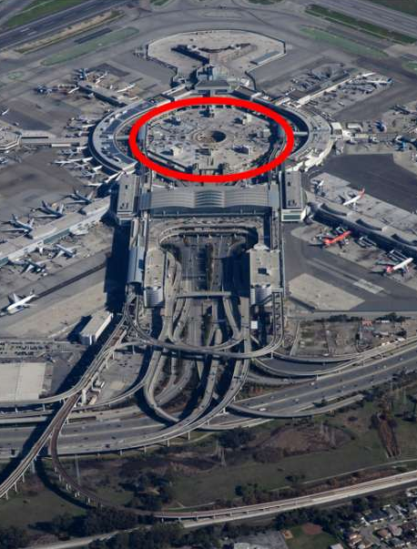
4. Charge the right prices for access to the curb
Example: San Francisco Airport
2018: ridehail pick-up/drop-off fees were $3.80/ride
Result: “25,000 ride-hail vehicles a day clog its roadways…double parking…traffic reduced to below 10 mph”
2019: ridehail pickups moved to garage
6 pickup zones
“traffic on the roadways is flowing smoothly”
Photo: SFO
Sources: https://www.sfchronicle.com/business/article/SFO-redirects-Uber-Lyft-pickups-to-ease-gridlock-13941761.php
http://abc7news.com/traffic/curbside-drop-off-pick-up-at-sfo-will-cost-more-for-lyft-uber-riders/3461564/
Notes:
Photo by Håkan Dahlström
Source for 2019 reference: https://www.sfchronicle.com/business/article/SFO-redirects-Uber-Lyft-pickups-to-ease-gridlock-13941761.php
Source for 2018 reference: http://abc7news.com/traffic/curbside-drop-off-pick-up-at-sfo-will-cost-more-for-lyft-uber-riders/3461564/

Slide 42
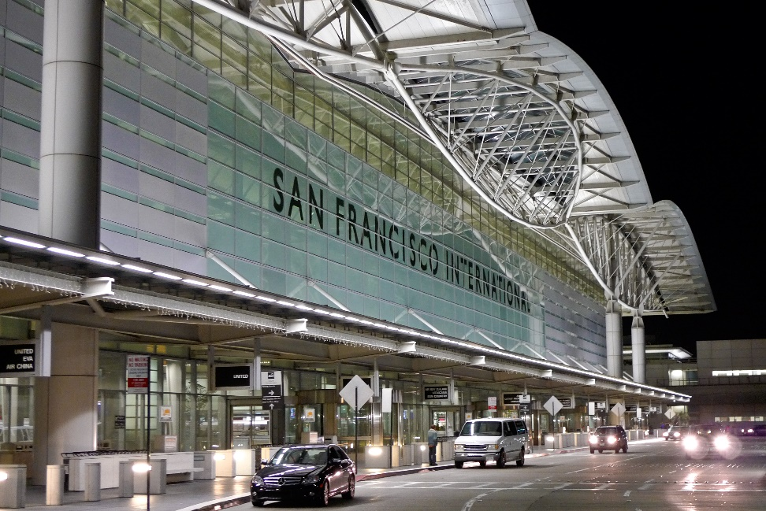
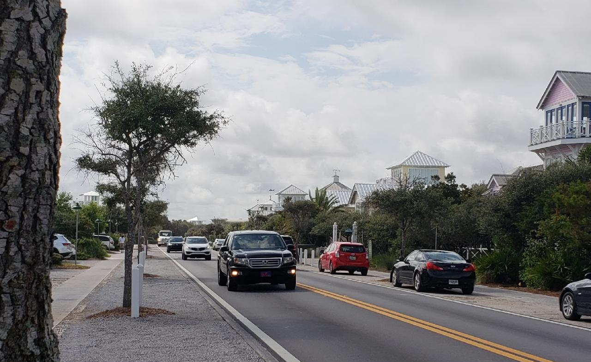
4. Charge the right prices for access to the curb
SFO’s current fees
$5/ride for curbside drop off
$3.60 per ride for garage pickup or drop-off
How can cities improve on this approach?
Charge fees that vary by time of day and by block
Higher fees for more congested times & locations
Lower fees for less congested times & locations
Photo: Håkan Dahlström
Photo: courtesy of Seaside Institute
Source: https://www.sfgate.com/travel/article/Uber-Lyft-fees-to-increase-at-SFO-13026867.php
Notes:
Source: https://www.sfgate.com/travel/article/Uber-Lyft-fees-to-increase-at-SFO-13026867.php

Slide 43
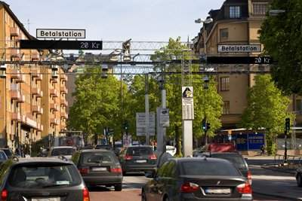
5. Charge the right prices for driving on streets
Stockholm congestion pricing
Fee: $1.35 to $2.70, varies by time of day
Traffic reduction after six months averages 22%
Queue times down 30% in AM peak, 50% in PM peak
Injuries: 10-14% reduction in inner city; 2-3% in County
Air pollution: -14% in inner city; -2.5% in county
Residents’ attitude: 44% positive before → 54% positive after
Notes:
Traffic reduction after six months averages 22%
Equivalent to 100,000 fewer vehicle passages per day
Photo source: https://www.roadtraffic-technology.com/projects/stockholm-congestion/

Slide 44
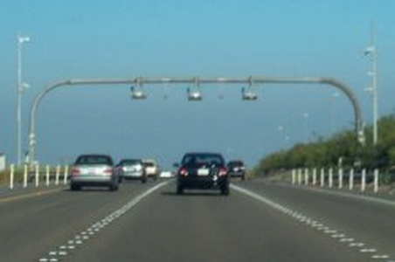
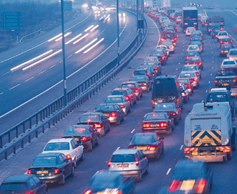
Congestion pricing in California
  “Express Lanes” on freeways
  Prices vary in real-time to keep traffic flowing freely
  Carpools, buses don’t pay
  Examples
  I-580 & I-680, Alameda County
  I-680, Contra Costa County
  SR-237, Santa Clara County
  SR-91, San Diego County
SR 91 Express Lanes RFID Station
Photo: Gary D at English Wikipedia
Notes:
“In July 2010 congestion pricing tolls were implemented at the San Francisco–Oakland Bay Bridge. The Bay Bridge congestion pricing scheme charges a US$6 toll from 5 a.m. to 10 a.m. and 3 p.m. to 7 p.m., Monday through Friday. During weekends cars pay US$5. Carpoolsbefore the implementation were exempted but now they pay US$2.50. The toll remained at the previous toll of US$4 at all other times on weekdays.^{[11]}
The Bay Area Toll Authority reported that by October 2010 fewer users are driving during the peak hours and more vehicles are crossing the Bay Bridge before and after the 5–10 a.m. period in which the congestion toll goes into effect. According to a study contracted to the University of California, Berkeley, commute delays in the first six months have dropped by an average of 15 percent compared with 2009. When the congestion tolls were proposed, the agency expected the scheme to produce a 20 to 30 percent drop in commute traffic. The study also found a decrease in the number of carpools since the first fee for carpools was introduced, with a reduction of 10,800 carpoolers when figures from September 2009 and 2010 are compared. The UC Berkeley study also provides evidence that some people are using BART to get to work in San Francisco instead of paying the higher tolls on the Bay Bridge during rush hour.^{[17][18]”}
Source: https://en.wikipedia.org/wiki/San_Francisco_congestion_pricing
Source: http://www.sfgate.com/bayarea/article/New-I-680-express-lanes-open-12262429.php
Source: http://511.org/driving/express-lanes/work

Slide 45
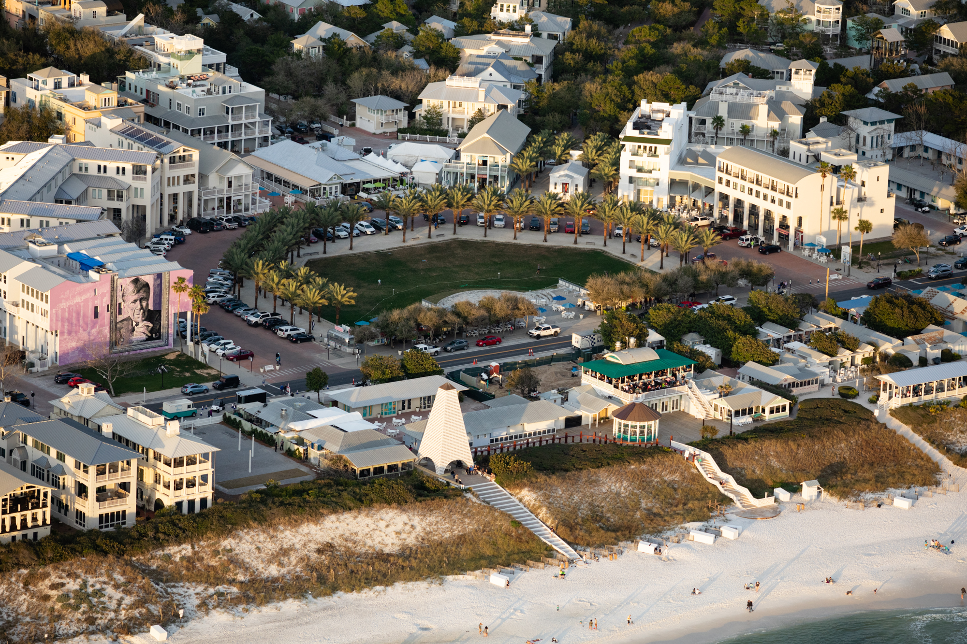
Parking & loading reforms to adopt today
Commercial Blocks
Charge the right prices for curb parking Return the parking revenue to the blocks where it is generated, to pay for public services Remove minimum parking regulations Loading: charge the right prices for curb access Charge the right prices for driving on streets
Photo: courtesy of Seaside Institute

Slide 46
Parking & loading reforms to adopt today
Residential Blocks
Charge the right prices for curb parking Existing residents: Grandfather in w/ free or cheap permits Future residents: Limit # of permits to # of curb spaces. Charge the right prices for curb parking Non-residents: Charge the right prices. Return the parking revenue to the neighborhood to pay for public services Remove minimum parking Regulations Loading: charge the right prices for curb access Charge the right prices for driving on streets
Photo: courtesy of Seaside Institute

Slide 47
Parking & loading reforms to adopt today
Commercial Blocks | Residential Blocks
Charge the right prices for curb parking Return the parking revenue to the blocks where it is generated, to pay for public services Remove minimum parking regulations Loading: charge the right prices for curb access Charge the right prices for driving on streets | Charge the right prices for curb parking Existing residents: Grandfather in w/ free or cheap permits Future residents: Limit # of permits to # of curb spaces. Charge the right prices for curb parking Non-residents: Charge the right prices. Return the parking revenue to the neighborhood to pay for public services Remove minimum parking Regulations Loading: charge the right prices for curb access Charge the right prices for driving on streets
Photo: courtesy of Seaside Institute

