Slide 1
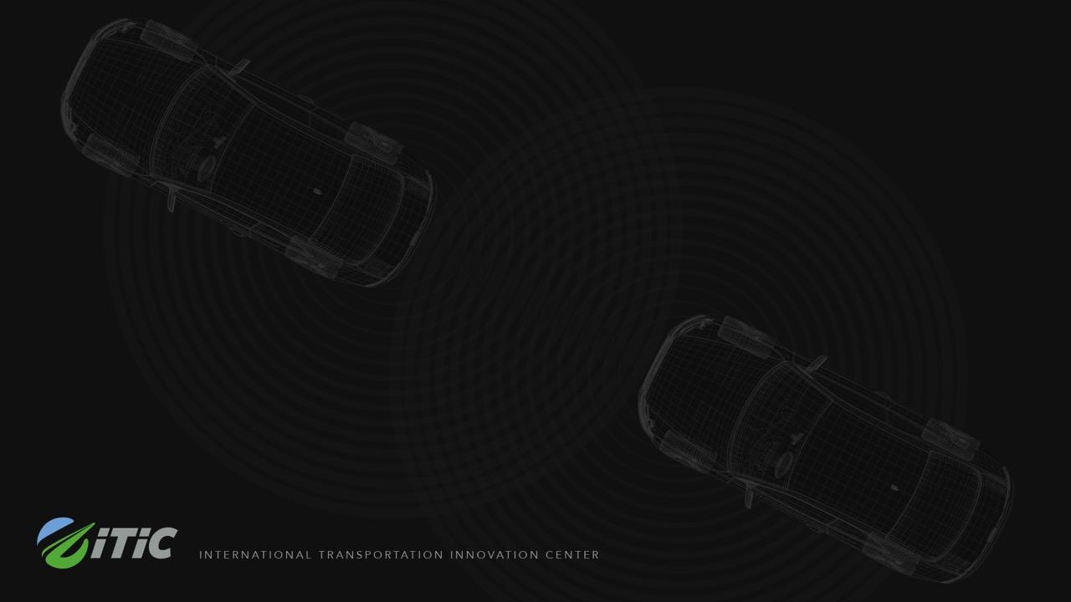

Technical capabilities of AV’s and aspects of infrastructure readiness
Prof. Dr. Joachim G. Taiber, Chief Technology Officer International Transportation Innovation Center (ITIC) and Adjunct Professor of the Clemson University International Center for Automotive Research (CU-ICAR)
Seaside, 2020
Future of Mobility: Walton County Workshop

Slide 2

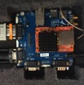
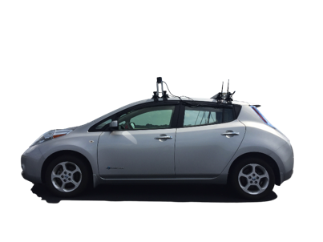



The rocky road from an AV prototype to an affordable AV series production vehicle
LIDAR and camera: Detect surrounding objects (e.g., vehicles and pedestrians) for collision avoidance
RTK-GPS: Provide high-accuracy position feedback
Actuation systems
RTK: Real Time Kinematic
IMU: Inertial Measurement Unit
DSRC: Dedicated Shortrange Communication
OBU: Onboard Unit
RSU: Roadside Unit
Multiple Communications: Onboard cellular network, high-power Wi-Fi to cover up to one mile test track, DSRC OBU and RSU units.
IMU: Provide yaw angle, speed, and time stamp feedback
Source: CUICAR

Slide 3

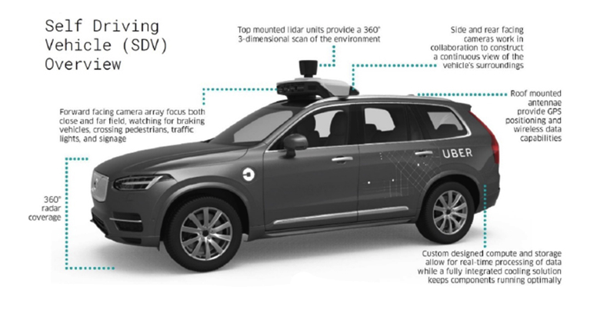
Lessons learnt from the Herzberg tragedy
Six seconds from detection to impact:
Radar detects Elaine Herzberg (quickly folloiwed
by lidar) but AV system cannot classify object as
pedestrian as bicyclist was not close to a crosswalk
Next five seconds system alternated between
classifying Herzberg as a vehicle, a bike and an
unknown object
Automated braking system was disabled to avoid
dars to interfer with Uber’s self-driving sensors
In the last second system surpressed braking and
handed control back to ther human safety driver
who was distracted
Source: IEEE Spectrum
Source: NTSB/Uber ATG
NHTSA to enforce safety self-assessment reports of companies that
want to test AV systems on public roads
Testing companies need to implement and enforce safety policy

Slide 4
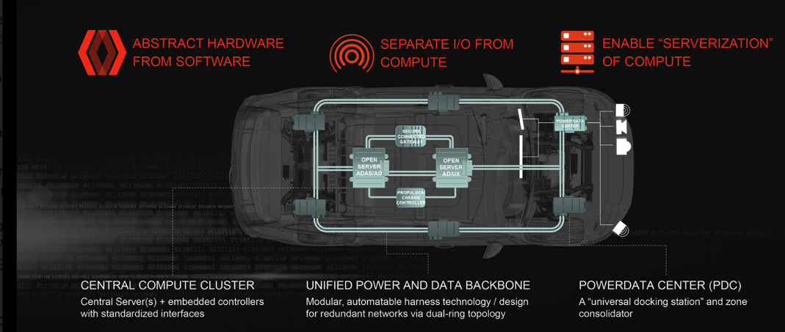
Redesign of in-vehicle hardware and software architecture for AV operation
Source: Aptiv

Slide 5
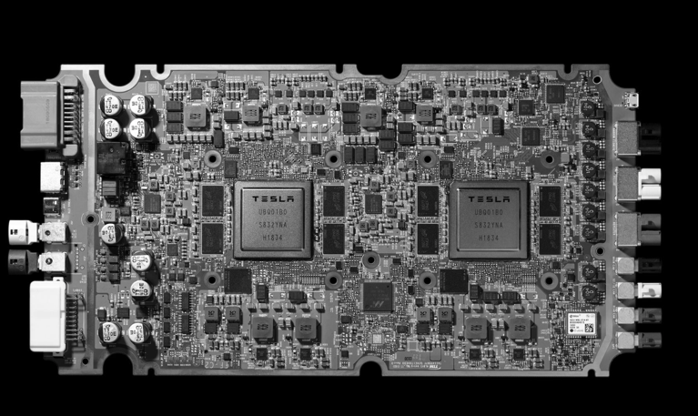
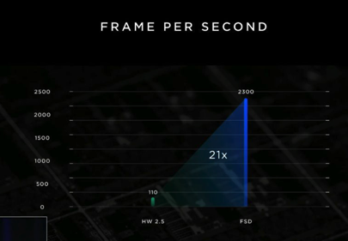
Tesla developed its first AV chip
Source: Tesla

Slide 6
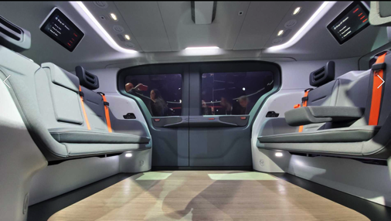
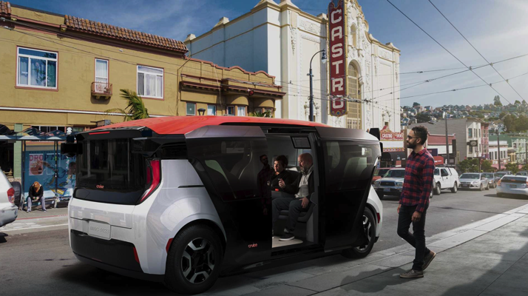
Purpose designed AV for large scale deployment
Source: Cruise
According to CEO of Cruise cost to produce the Origin at volume will be half the cost of an electric SUV

Slide 7
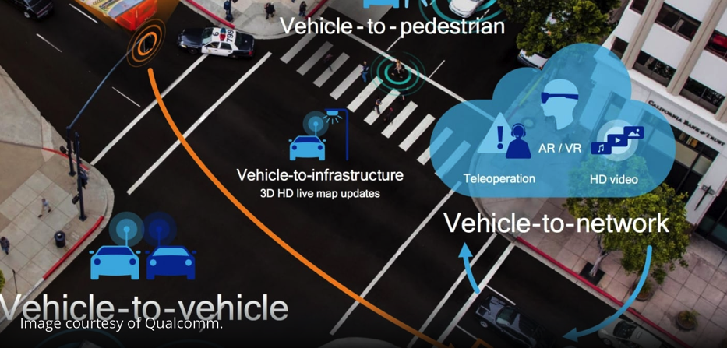
The importance of V2X in context of AV
5G mass deployment will support the capabilities of V2X to keep AV operation safe and secure

Slide 8
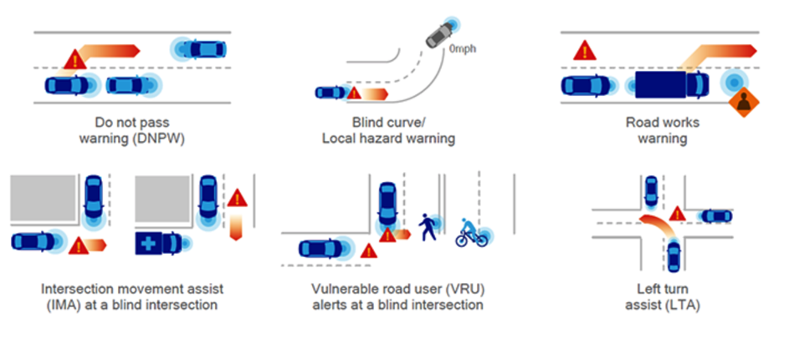
Low latency C-V2X active safety use cases
Source: Qualcomm
In this operational mode the unlicensed 5.9 GHz band is being used

Slide 9
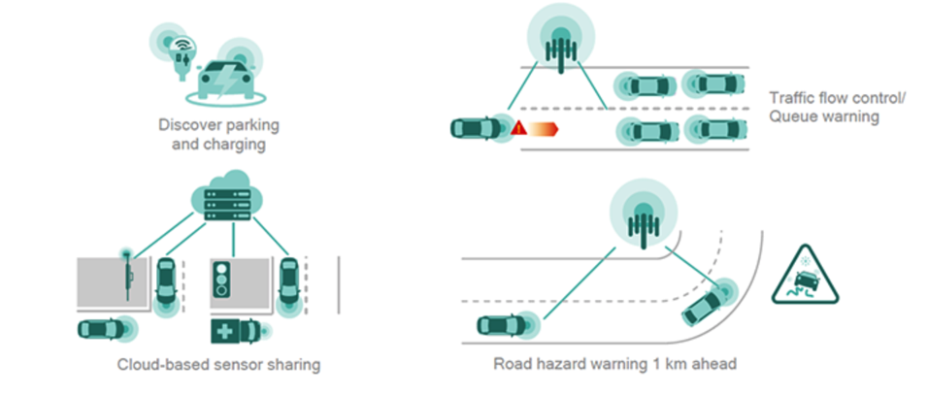
Latency tolerant C-V2X use cases
Source: Qualcomm
In this operational mode the regular license-band cellular network is being used

Slide 10
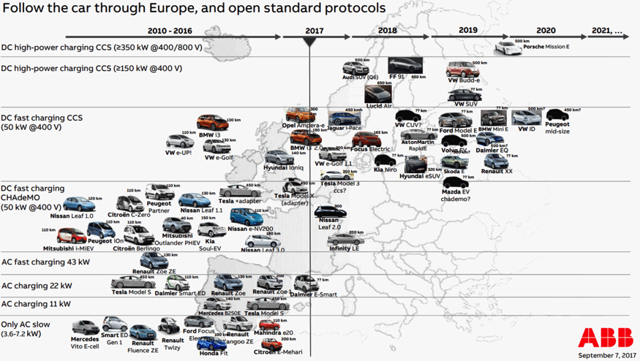
Development of EV charging technology

Slide 11
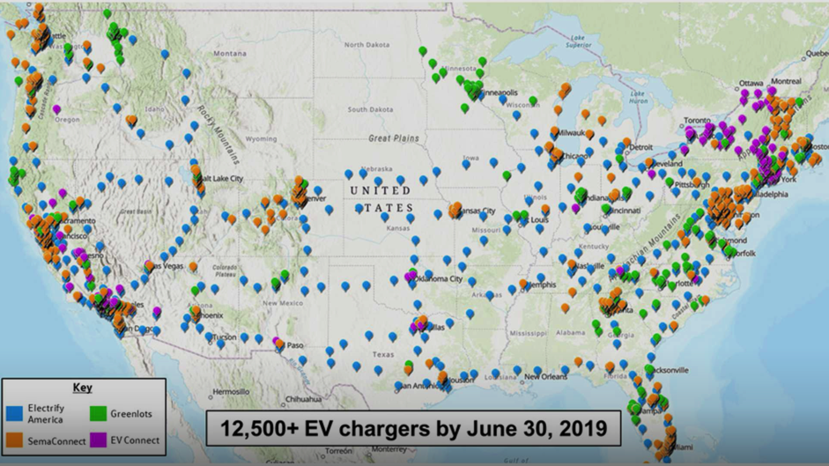
National network of interoperable chargers
Source: Electrify America

Slide 12

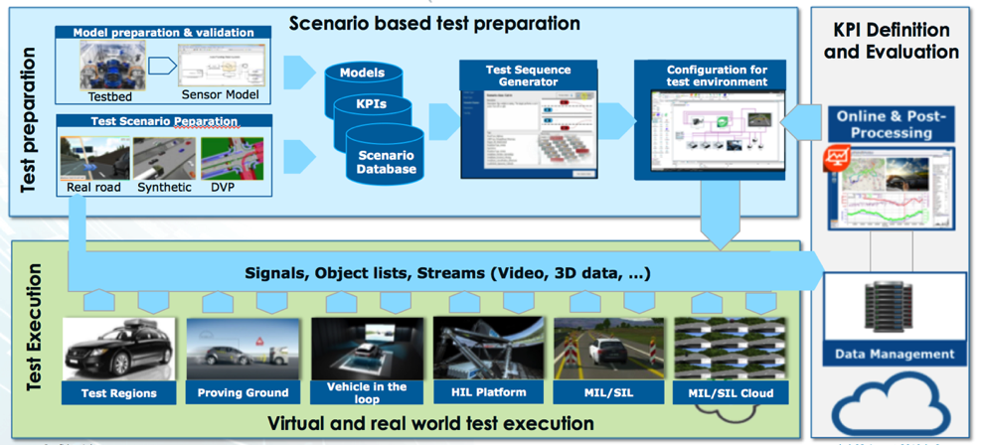
The importance of standardized testing in
AV development
Source: AVL

Slide 13
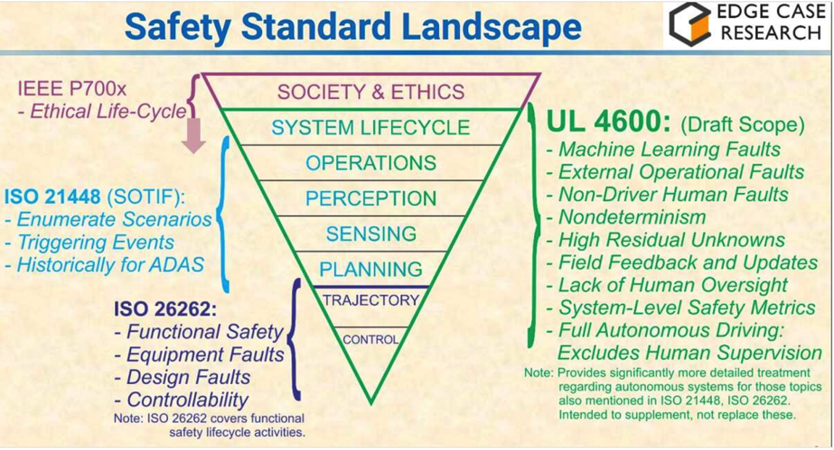
Safety standard landscape
Source: Phil Koopman, Edge Case Research

Slide 14

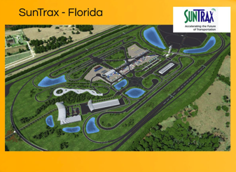




Interaction of closed and open testbed
Business model validation and
customer adoption assessment
with real customers
Generation of real world test
data sets
Technology validation of multi-modal
mobility service model with
simulated customers
Utilization of real world test data sets

Slide 15
How to improve safety and security through teleoperation
https://www.youtube.com/watch?v=m27yDTZz7pw&feature=youtu.be

Slide 16
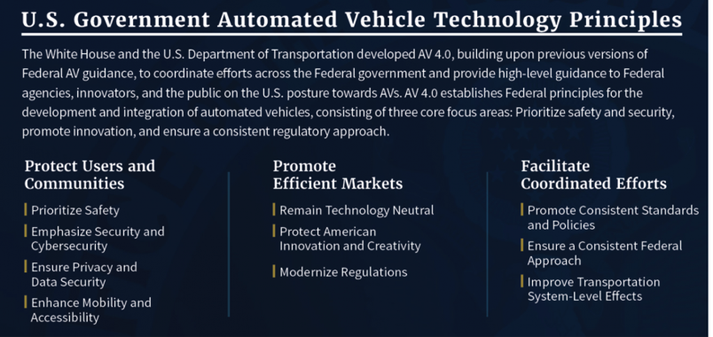
Automated Vehicle Technology Principles
https://www.transportation.gov/policy-initiatives/automated-vehicles/av-40

